Slide 1
7/13 Lecture Agenda
Announcements
Part 4-1: Graphs and BFS
10 minute break!
Part 4-2: Dijkstra's Algorithm

Slide 2

Announcements!
Pre-HW3 due tonight!
Pre-HW4 out tonight!
HW3 templates and autograders
HW2 solutions out soon, so you can study…
HW1 grading continues, but solutions are out
This is the last lecture in scope for the midterm!

Slide 3
7/13 Lecture Agenda
Announcements
Part 4-1: Graphs and BFS
10 minute break!
Part 4-2: Dijkstra's Algorithm

Slide 4


Divide and Conquer Sorting & Randomization Data Structures
Graph Search
Dynamic Programming Greed & Flow
Special Topics
BFS: Steady And Not Slow

Slide 5
Graph terminology review
n vertices (AKA nodes)
m edges
There are (n choose 2)
= n(n-1) / 2 pairs of vertices, so there can be up to that many edges as well!
But there could be as few as 0 edges…

Slide 6
The exact way a graph is drawn doesn't matter
=
Try to avoid crossing edges when you don't have to, though. It's confusing

Slide 7
Adjacency list representation
1: [3, 5]
2: [4]
3: [1, 5]
4: [2]
5: [1, 3]
6: []
and this could itself be an array with these six lists as values
1
2
:
6
3
5
4

Slide 8
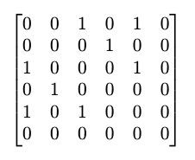
Matrix representation (less common)
1
2
:
6
3
5
4
O(n²) storage space, though in practice we have good ways of storing "sparse" matrices

Slide 9
This graph has three connected components.
1
2
6
3
5
4

Slide 10
This graph is "connected" (i.e., has one connected component).
6
In a connected graph, there is (at least one) path between any two vertices.
1
2
3
5
4

Slide 11
This graph has three "distinct" cycles.
1-5-3-1
6
1-6-4-5-1
1-6-4-5-3-1
(and their reverses)
1
2
The exact deﬁnition of cycles, and counting cycles, generally won't be too important for us in 161.
3
5
4

Slide 12



So far all our edges have been undirected
1
1
2
1
2
2
Directed edges are one-way.
They change the game somewhat! We'll meet them next lecture.
An undirected edge can be thought of as two directed edges.

Slide 13
We'll usually pretend these don't exist
between the same two vertices was important for Karger's Algorithm, but we generally don't think about these "multigraphs" when we talk about graphs.
Allowing multiple edges
1
2
1
We also won't be doing this. (i.e., no "self-loops")

Slide 14
How many steps apart are two vertices?
6
1
2
1 and 2 are at least three steps apart. (and there are two equally short paths)
3
5
4

Slide 15
Let's start with a simpler problem: exploration
6
1
2
Can the yellow vertex 3 reach all other vertices?
Sure, it looks visually obvious here. But imagine instead that you have a 1000000-vertex graph, as an adjacency list…
3
5
4

Slide 16

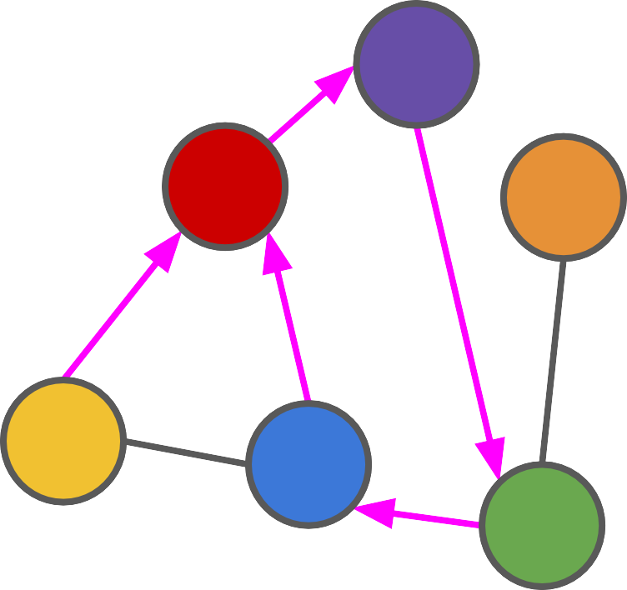
6
1
2
3
5
4

Slide 17
OK, I got stuck, but that's probably all of them!
6
1
2
3
5
4

Slide 18

OK, I got stuck, but that's probably all of them!
6
1
2
If we just explore wildly, we might miss something! We need a plan.
3
5
4

Slide 19
Breadth-First Traversal: The Idea
Visit all vertices that are directly connected to the start vertex.
Then visit all vertices that are directly connected to those vertices.
And so on…

Slide 20
Breadth-First Traversal
Create a queue of vertices to visit.
Initially, it just has the starting vertex.
6
1
2
Repeat the following:
Pop off the ﬁrst value in the queue.
Follow each of its edges (in some order), putting the vertices you ﬁnd in the queue.
3
5
4

Slide 21
Breadth-First Traversal
Start: [3]
Pop 3: []
6
Inspect 3: it has edges to 1 and 5. Say we go in color order.
1
2
Add 1: [1]
Add 5: [1, 5]
Done with 3!
3
Pop 1: [5]
5
4
Inspect 1: it has edges to 3, 5, and
6.
Add 3: [5, 3]... wait a minute

Slide 22
Avoiding Revisits!
Once we've visited a vertex and followed all its edges, there is never a reason to go back.
If we already found it earlier, our new way of ﬁnding it is just a slower way of getting there!
We can maintain a single Boolean variable per vertex to indicate whether we've visited it.

Slide 23
Breadth-First Traversal
Create a queue of vertices to visit.
Initially, it just has the starting vertex.
6
Repeat the following:
Pop off the ﬁrst value in the queue.
Mark it as VISITED.
Follow each of its edges (in some order), putting the vertices you ﬁnd in the queue as long as they are not VISITED.
1
2
3
5
4

Slide 24
Breadth-First Traversal
Start: [3]
Pop 3: []
Mark 3 as VISITED.
6
Inspect 3: it has edges to 1 and 5.
1
Add 1: [1]
2
Add 5: [1, 5]
Done with 3!
Pop 1: [1]
3
Mark 1 as VISITED.
5
4
Inspect 1: it has edges to 3, 5, and 6.
Do not add 3, since it is VISITED.
Add 5: [5, 5]… wait a minute

Slide 25
Avoiding Duplicates In The Queue!
One idea: before putting something in the queue, check to see if it's already there…
But it would take time linear in the size of the queue to check!
OK, then let's make the queue a set.
But then we lose the order on the vertices!
Better idea: think of the Boolean as marking a vertex as INSERTED instead of as VISITED.

Slide 26
Breadth-First Traversal
Create a queue of vertices to visit.
Initially, it just has the starting vertex.
Mark the starting vertex as INSERTED.
6
1
2
Repeat the following:
Pop off the ﬁrst value in the queue.
Follow each of its edges (in some order), putting the vertices you ﬁnd in the queue (and marking them as INSERTED) as long as they are not INSERTED.
3
5
4

Slide 27
Breadth-First Traversal
Queue: [3]
Inserted: [F, F, T, F, F, F]
6
Currently processing: None
1
2
3
5
4

Slide 28
Breadth-First Traversal
Queue: []
Inserted: [F, F, T, F, F, F]
6
Currently processing: 3
1
2
3
5
4

Slide 29
Breadth-First Traversal
Queue: []
Inserted: [F, F, T, F, F, F]
6
Currently processing: 3
Neighbors: 1, 5
1
2
3
5
4

Slide 30
Breadth-First Traversal
Queue: [1]
Inserted: [T, F, T, F, F, F]
6
Currently processing: 3
Neighbors: 1, 5
1 is not inserted, so set it to inserted and add it to the queue
1
2
3
5
4

Slide 31
Breadth-First Traversal
Queue: [1, 5]
Inserted: [T, F, T, F, T, F]
6
Currently processing: 3
Neighbors: 1, 5
1 is not inserted, so set it to inserted and add it to the queue
5 is not inserted, so set it to inserted and add it to the queue
Done processing 3!
1
2
3
5
4

Slide 32
Breadth-First Traversal
Queue: [5]
Inserted: [T, F, T, F, T, F]
6
Currently processing: 1
Neighbors: 3, 5, 6
1
2
3
5
4

Slide 33
Breadth-First Traversal
Queue: [5]
Inserted: [T, F, T, F, T, F]
6
Currently processing: 1
Neighbors: 3, 5, 6
3 is inserted, so ignore it.
5 is inserted, so ignore it.
1
2
3
5
4

Slide 34
Breadth-First Traversal
Queue: [5, 6]
Inserted: [T, F, T, F, T, T]
6
Currently processing: 1
Neighbors: 3, 5, 6
3 is inserted, so ignore it.
5 is inserted, so ignore it.
6 is not inserted, so set it to inserted and add it to the queue
Done processing 1!
1
2
3
5
4

Slide 35
Breadth-First Traversal
Queue: [6]
Inserted: [T, F, T, F, T, T]
6
Currently processing: 5
1
2
3
5
4

Slide 36
Breadth-First Traversal
Queue: [6]
Inserted: [T, F, T, F, T, T]
6
Currently processing: 5
Neighbors: 1, 3, 4
1 is inserted, so ignore it.
3 is inserted, so ignore it.
1
2
3
5
4

Slide 37
Breadth-First Traversal
Queue: [6, 4]
Inserted: [T, F, T, T, T, T]
6
Currently processing: 5
Neighbors: 1, 3, 4
1 is inserted, so ignore it.
3 is inserted, so ignore it.
4 is not inserted, so set it to inserted and add it to the queue
Done processing 5!
1
2
3
5
4

Slide 38
Breadth-First Traversal
Queue: [4]
Inserted: [T, F, T, T, T, T]
6
Currently processing: 6
1
2
3
5
4

Slide 39
Breadth-First Traversal
Queue: [4]
Inserted: [T, F, T, T, T, T]
6
Currently processing: 6
Neighbors: 1, 4
1 is inserted, so ignore it.
4 is inserted, so ignore it.
Done processing 6!
1
2
3
5
4

Slide 40
Breadth-First Traversal
Queue: []
Inserted: [T, F, T, T, T, T]
6
Currently processing: 4
Neighbors: 2, 5, 6
1
2
3
5
4

Slide 41
Breadth-First Traversal
Queue: [2]
Inserted: [T, T, T, T, T, T]
6
Currently processing: 4
Neighbors: 2, 5, 6
2 is not inserted, so set it to inserted and add it to the queue
1
2
3
5
4

Slide 42
Breadth-First Traversal
Queue: [2]
Inserted: [T, T, T, T, T, T]
6
Currently processing: 4
Neighbors: 2, 5, 6
2 is not inserted, so set it to inserted and add it to the queue
5 is inserted, so ignore it.
6 is inserted, so ignore it.
Done processing 4!
1
2
3
5
4

Slide 43
Breadth-First Traversal
Queue: []
Inserted: [T, T, T, T, T, T]
6
Currently processing: 2
Neighbors: 4
4 is inserted, so ignore it.
Done processing 2!
1
2
3
5
4

Slide 44
Breadth-First Traversal
Queue: []
Inserted: [T, T, T, T, T, T]
6
Currently processing: 2
Neighbors: 4
4 is inserted, so ignore it.
Done processing 2!
1
2
Queue is empty, so we stop.
3
5
4

Slide 45
Breadth-First Traversal
Queue: []
Inserted: [T, T, T, T, T, T]
6
Currently processing: 2
Neighbors: 4
4 is inserted, so ignore it.
Done processing 2!
1
2
3
5
We reached every vertex!
4

Slide 46
Running Time
We have to visit each of the n vertices at least once to look at its neighbors in the adjacency list.
We consider each of the m edges at most twice (once each in its two vertices' adjacency lists)
Running time: O(n + m)

Slide 47
Running Time
We have to visit each of the n vertices at least once to look at its neighbors in the adjacency list.
We consider each of the m edges at most twice (once each in its two vertices' adjacency lists)
Running time: O(n + m)
But m can itself be ϴ(n²). Why not say O(n²)?

Slide 48
Running Time
We have to visit each of the n vertices at least once to look at its neighbors in the adjacency list.
We consider each of the m edges at most twice (once each in its two vertices' adjacency lists)
Running time: O(n + m)
But m can itself be ϴ(n²). Why not say O(n²)? True, but this is more informative / ﬂexible the way it is. What if the graph is a tree with O(n) edges?

Slide 49
Counting connected components
Proceed through the vertices in order 1, 2, …, doing the following:
If a vertex has not been SEEN:
Perform a breadth-ﬁrst traversal on it and mark all encountered nodes as SEEN.
Increment the count of connected components.
Otherwise, do nothing.

Slide 50
Counting connected components
 | 1 |  | 6 | 2 | 1: Mark 1, 3, 5 as SEEN. 2. Mark 2, 4 as SEEN. | +1 +1
 |  |  |  |  | 3. Skip (3 is SEEN)
3 |  | 5 |  | 4 | 4. Skip (4 is SEEN) 6. Mark 6 as SEEN. | +1
5. Skip (5 is SEEN)

Slide 51
How many steps apart are two vertices?
6
1
2
Oh, right, we wanted to solve this! For each other vertex, what's the fastest way to get there from 1?
3
How should we approach this?
5
4

Slide 52
Shortest Distance
Do the same BFS traversal, but label each vertex with a distance, starting from 0 at the start vertex.
Distance = 1 + the distance of the vertex that led us here.
What if a vertex already has a distance at the time we try to set the distance? Can our new value be better?

Slide 53
Shortest Distance
Do the same BFS traversal, but label each vertex with a distance, starting from 0 at the start vertex.
Distance = 1 + the distance of the vertex that led us here.
What if a vertex already has a distance at the time we try to set the distance? Can our new value be better? No – let's see why.

Slide 54
Generations of the queue
Start: 3
After fully processing 3, we had: 1, 5
6
1
2
After fully processing 1, 5,
we had: 6, 4
After fully processing 6, 4,
we had: 2
3
5
4
After fully processing 2: we were done

Slide 55
Generations of the queue
Start: 3
After fully processing 3, we had: 1, 5
6
1
2
After fully processing 1, 5,
we had: 6, 4
After fully processing 6, 4,
we had: 2
3
5
4
2
After fully processing 2: we were done
dist 0
3
1

Slide 56
Shortest Distances
Create a queue with just the starting vertex.
Mark the starting vertex as INSERTED, and set its distance to 0.
6
Set roundNum = 1.
1
2
3
5
4

Slide 57
Shortest Distances
Create a queue with just the starting vertex.
Mark the starting vertex as INSERTED, and set its distance to 0.
6
Set roundNum = 1.
1
2
Repeat the following:
Create a new empty queue.
For each value in the old queue, in order:
Process it as before, putting its non-INSERTED neighbors in the new queue.
Label its distance as roundNum.
Increment roundNum.
New queue = old queue.
3
5
4
2
dist 0
3
1

Slide 58



Now you're equipped for

Slide 59
The Divergent Hunger Maze!
You and your partner have been trapped in a maze with two ﬂoors. (Think of them as being superimposed, one atop the other.)
You each start in the lower left corner, but on separate ﬂoors. You are each trying to get to the upper right corner of your ﬂoor…
…but you always have to stay within k moves of each other so you can exchange awkward quips through the ﬂoor/ceiling.
You also want to use as few combined moves as possible.

Slide 60


Floor 1
stay within 2 moves
Floor 2
0 moves so far

Slide 61
Floor 1
stay within 2 moves
Floor 2
4 moves so far

Slide 62
Floor 1
stay within 2 moves
Floor 2
5 moves so far

Slide 63
Floor 1
stay within 2 moves
Floor 2
9 moves so far

Slide 64
Floor 1
stay within 2 moves
Floor 2
14 moves so far

Slide 65
Floor 1
stay within 2 moves
Floor 2
16 moves so far

Slide 66

We know how to solve these mazes individually
Just use BFS!
But how do we solve them at the same time, given that they constrain each other?

Slide 67
An Algorithm
Each state of this process can be described by the positions of the two people.
Not all states are legal.
To ﬁnd the states reachable from a given state, try moving each of the people in all possible directions, and also checking that they don't get too far apart.
Run BFS on this combined graph.

Slide 68
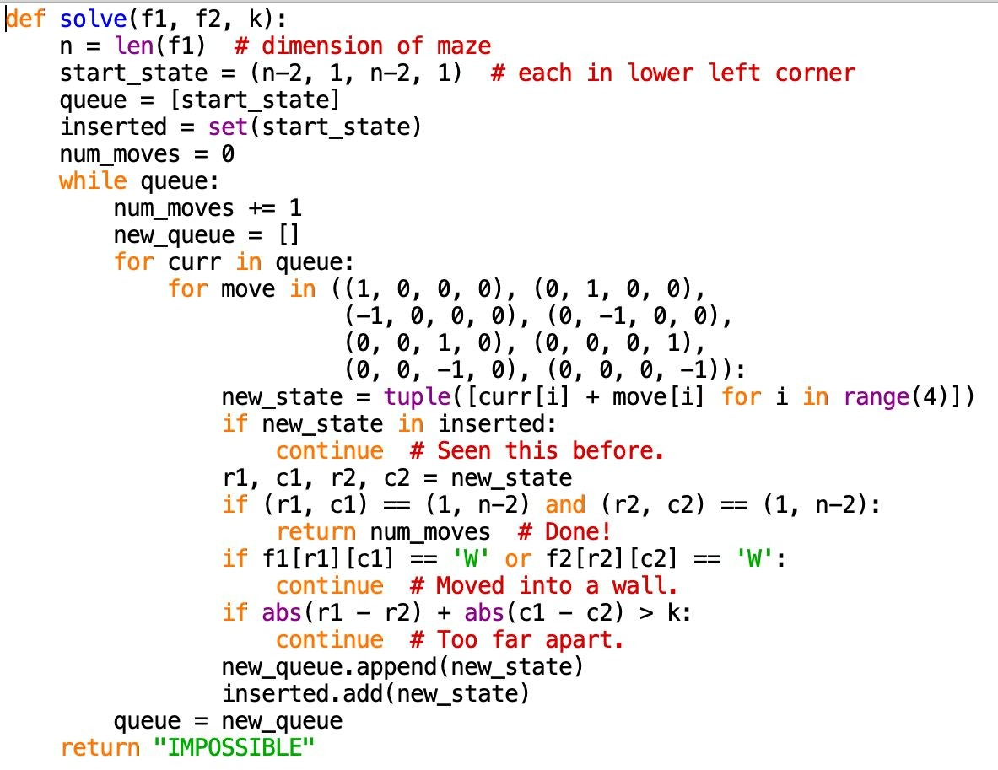
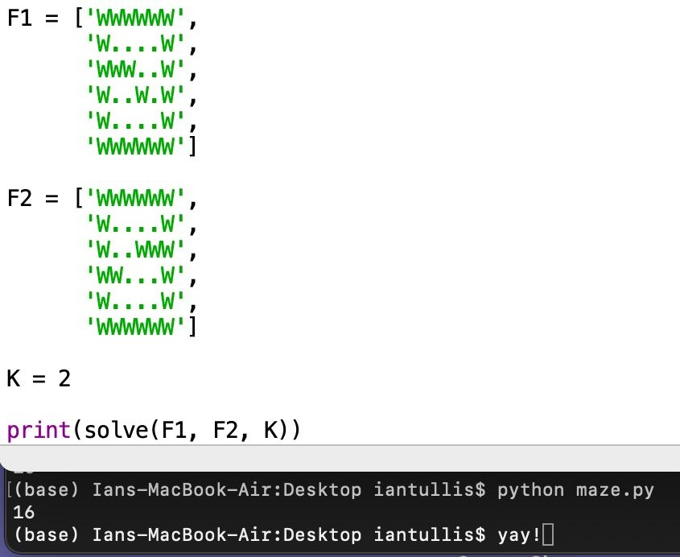

Slide 69
More graph terminology!
A graph is bipartite if it can be divided into exactly two groups, such that every edge goes between the groups (i.e., no edges within groups).
This here graph is bipartite!

Slide 70
(Why do we care about bipartiteness?)
This is the basis of matching problems. E.g., suppose that the vertices on the top are people, and the vertices on the bottom are jobs, and edges show who can do what. Can we give everyone exactly one job?
We'll return to this in Unit 6 (Greed & Flow).

Slide 71
(Why do we care about bipartiteness?)
This is the basis of matching problems. E.g., suppose that the vertices on the top are people, and the vertices on the bottom are jobs, and edges show who can do what. Can we give everyone exactly one job?
We'll return to this in Unit 6 (Greed & Flow).

Slide 72



(Why do we care about bipartiteness?)
1
3
This is also the basis of problems like: You know of a bunch of pairs of people who won't work together. Can you split them into two groups while honoring all of their requests?
2
4
6
2
5
4

Slide 73
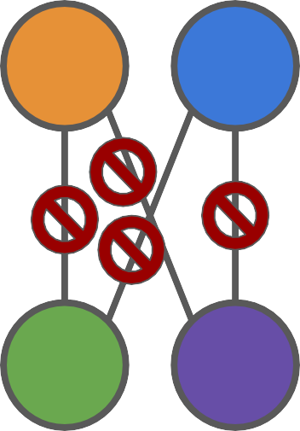
(Why do we care about bipartiteness?)
1
3
1
2
5
2
4
6
2
3
4
6
5
4
Success!

Slide 74
When is a graph not bipartite?
This graph looks like it is not bipartite.
How do we know? What if we just picked the wrong groups? Can we shift stuff around?

Slide 75
When is a graph not bipartite?
This graph looks like it is not bipartite.
How do we know? What if we just picked the wrong groups? Can we shift stuff around?

Slide 76
When is a graph not bipartite?
This graph looks like it is not bipartite.
How do we know? What if we just picked the wrong groups? Can we shift stuff around?

Slide 77
When is a graph not bipartite?
This graph looks like it is not bipartite.
How do we know? What if we just picked the wrong groups? Can we shift stuff around? No!
Observe that it has a cycle of odd length. No amount of rearranging can change that!

Slide 78

A graph is bipartite if and only if it has no odd cycles.
doomed!

Slide 79
A graph is bipartite if and only if it has no odd cycles.

Slide 80
Is this graph bipartite?
Directly looking for odd cycles seems pretty inefficient!

Slide 81
Is this graph bipartite?
Another way to check: Try to color each vertex red or blue, such that no two edges share a color.

Slide 82
Is this graph bipartite?
(arbitrary starting point and color)
Another way to check: Try to color each vertex red or blue, such that no two edges share a color.

Slide 83
Is this graph bipartite?
Its neighbors are forced to be blue.
Another way to check: Try to color each vertex red or blue, such that no two edges share a color.

Slide 84
Is this graph bipartite?
And neighbors of those vertices are forced to be red…
Another way to check: Try to color each vertex red or blue, such that no two edges share a color.

Slide 85
Is this graph bipartite? No!
Another way to check: Try to color each vertex red or blue, such that no two edges share a color.
Oh no!

Slide 86
Is this graph bipartite? No!
Another way to check: Try to color each vertex red or blue, such that no two edges share a color.
We didn't even make any choices except where to start! And that doesn't matter…

Slide 87
Is this graph bipartite? No!
The culprit: a subtle odd cycle…

Slide 88
7/13 Lecture Agenda
Announcements
Part 4-1: Graphs and BFS
10 minute break!
Part 4-2: Dijkstra's Algorithm

Slide 89
7/13 Lecture Agenda
Announcements
Part 4-1: Graphs and BFS
10 minute break!
Part 4-2: Dijkstra's Algorithm

Slide 90

Divide and Conquer Sorting & Randomization Data Structures
Graph Search
Dynamic Programming Greed & Flow
Special Topics
The i, j, k In Dijkstia Aie In Oidei

Slide 91
What if edges have weights?
2
F
We'll give the vertices letters instead just so there aren't so many numbers ﬂying around…
A
B
1
1
2
2
C
E
2
D
3

Slide 92
What's the lowest-cost path from C to D?
2
F
It's not necessarily the path with the fewest steps…
A
B
1
1
2
2
C
E
2
D
3

Slide 93
What's the lowest-cost path from C to D?
2
F
It's not necessarily the path with the fewest steps…
A
B
1
1
2
…this path with more steps is actually cheaper overall!
2
C
E
2
D
3

Slide 94
Can we adapt BFS to work?
2
F
A
B
1
1
2
2
C
E
2
D
3

Slide 95
Can we adapt BFS to work?
2
F
When the weights are very small positive integers, one hacky solution is to add fake nodes!
A
B
1
1
2
2
C
E
2
D
3

Slide 96
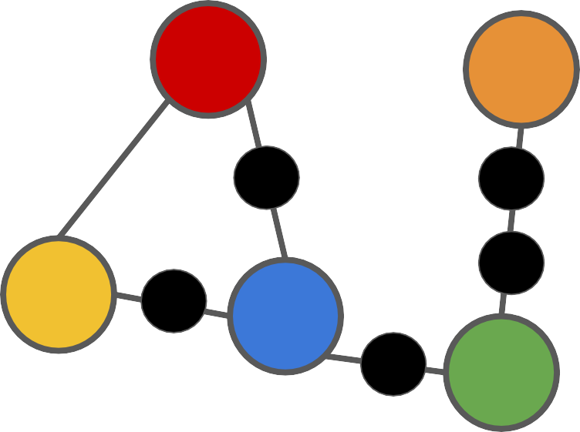

Can we adapt BFS to work? Kind of…
Now our BFS method for ﬁnding shortest distances works!
F
A
B
C
E
D

Slide 97

…but not always
43
F
A
B
999999999
1.234
2
0.0000001
C
E
1
D
77

Slide 98
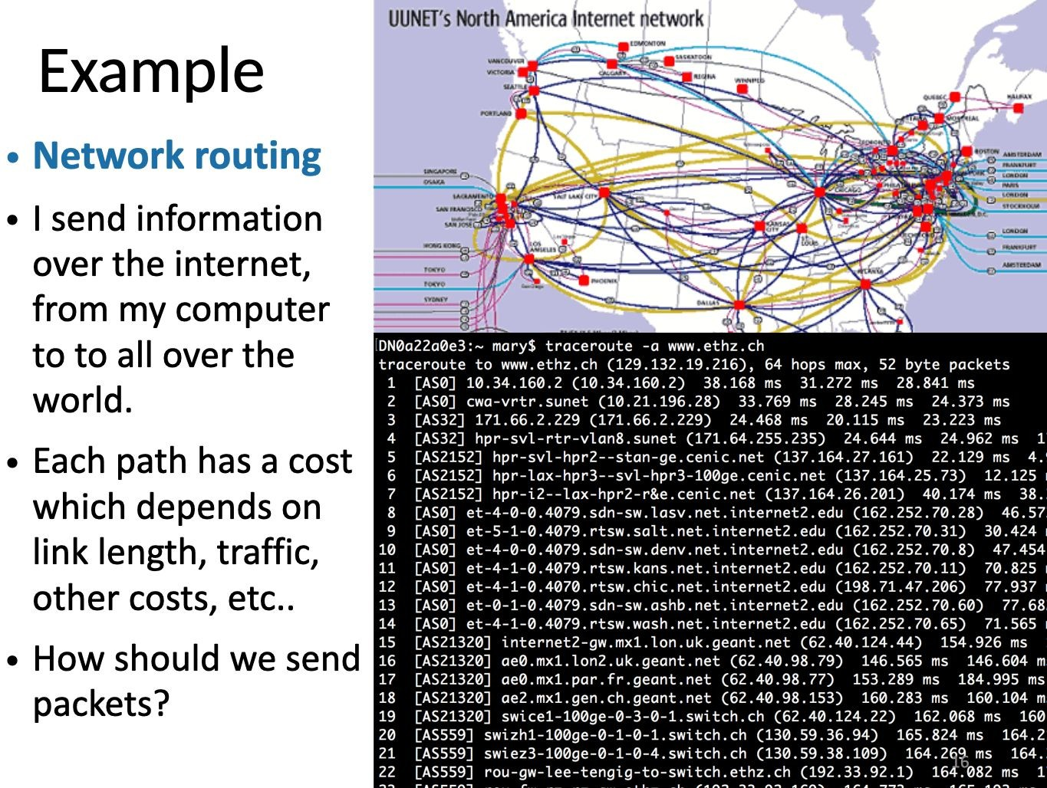

Slide 99
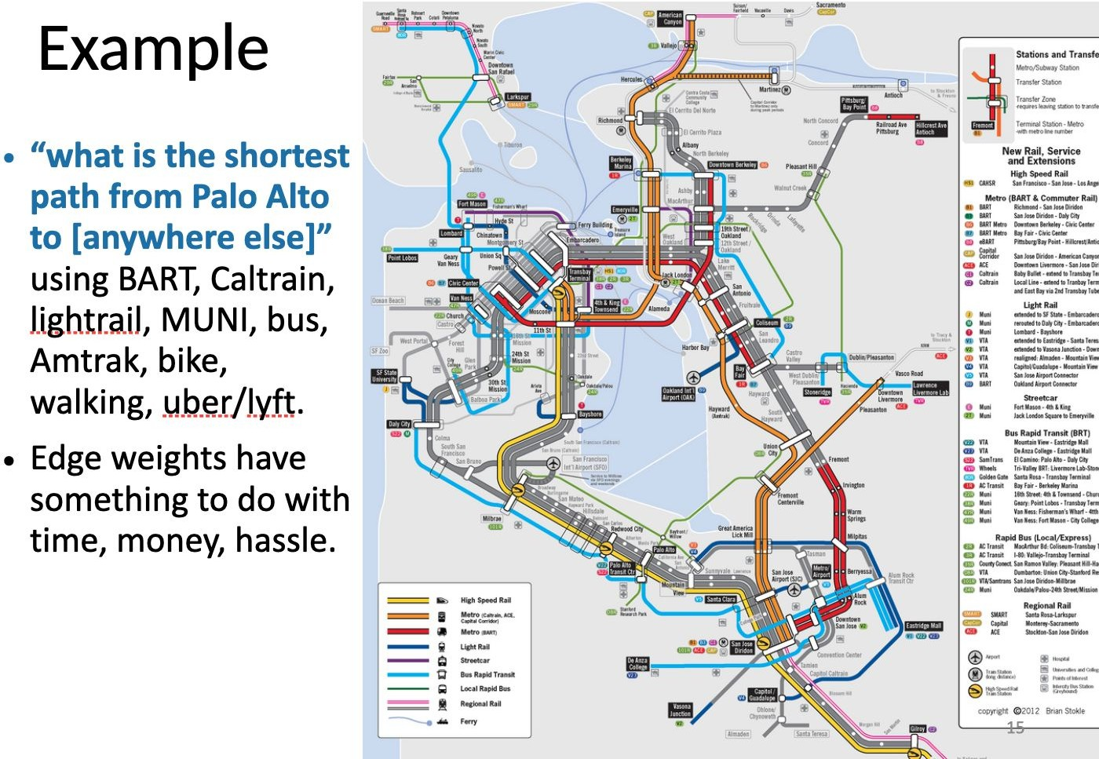

Slide 100
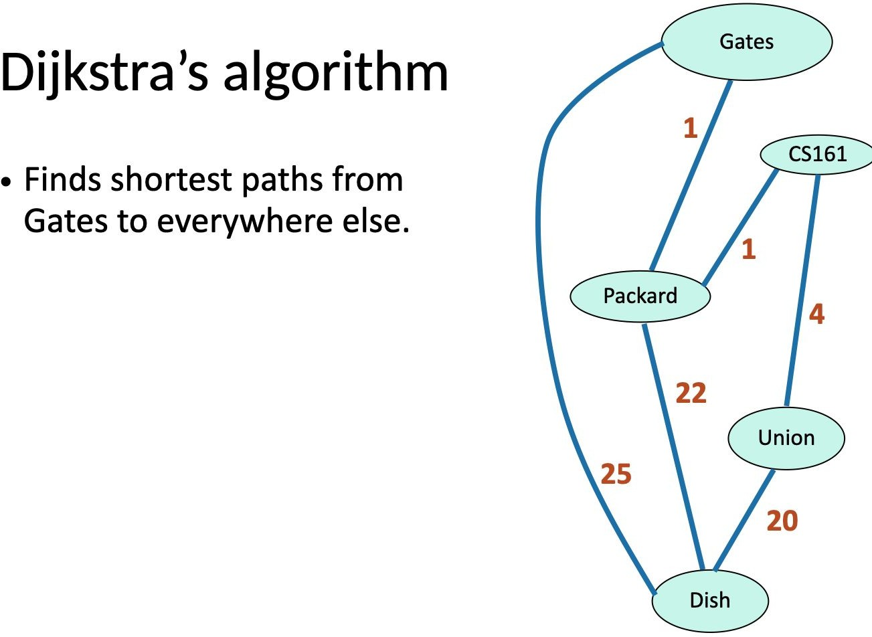

Slide 101
A quick word on the triangle inequality
For pathﬁnding in the real world, it might seem like we can also use the triangle inequality:
a + b ≥ c
b
a
c

Slide 102
A quick word on the triangle inequality
For pathﬁnding in the real world, it might seem like we can also use the triangle inequality:
a + b ≥ c
This would be true in a ﬂat plane, but what if path c has a big hill in the middle that a and b avoid? Or what if one path is muddy?
b
a
c
Even the same path might take different amounts of time in different directions!

Slide 103
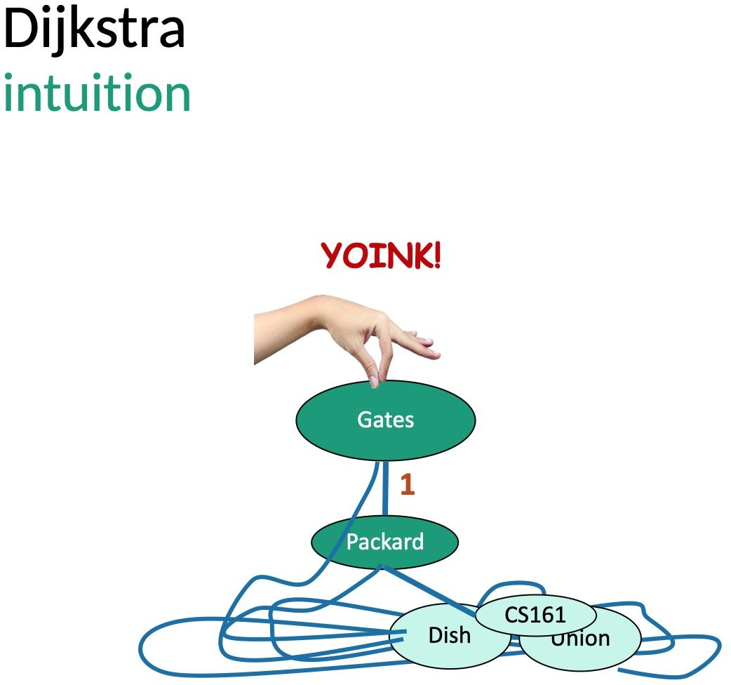

Slide 104
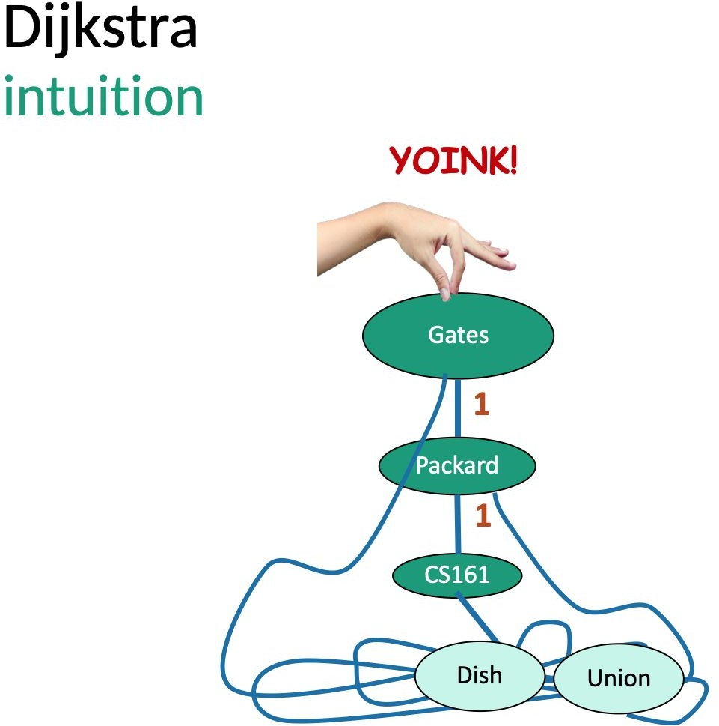

Slide 105
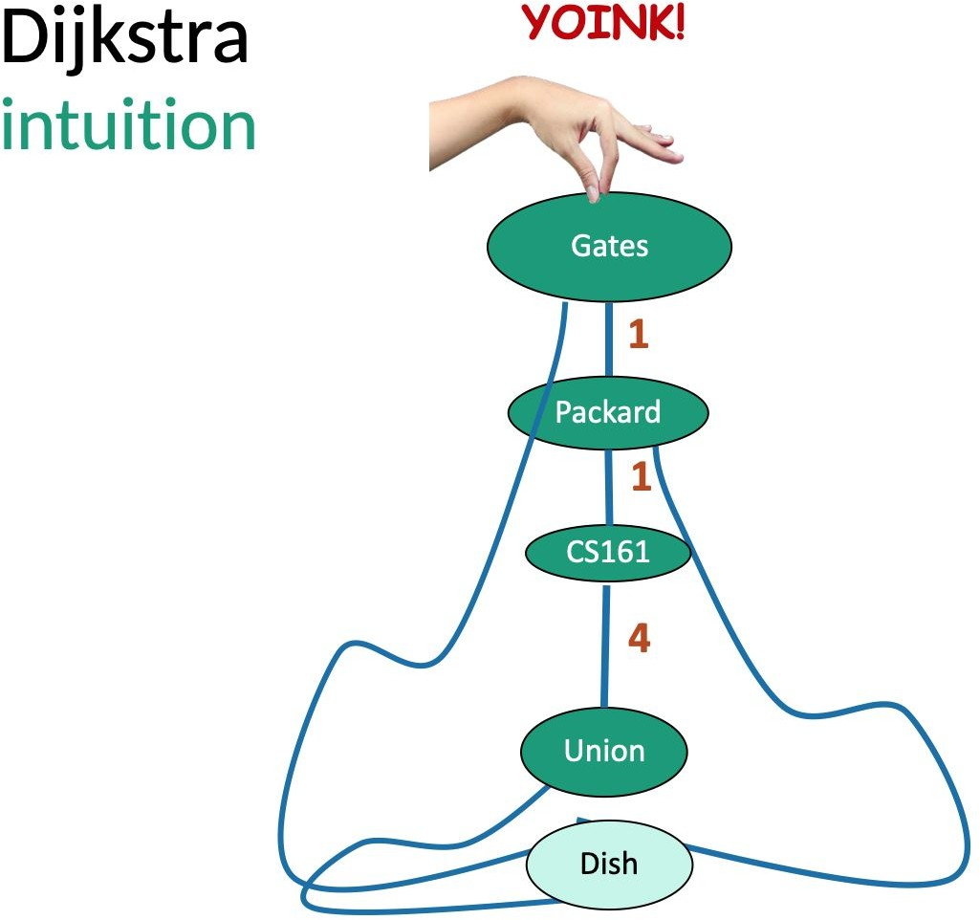

Slide 106
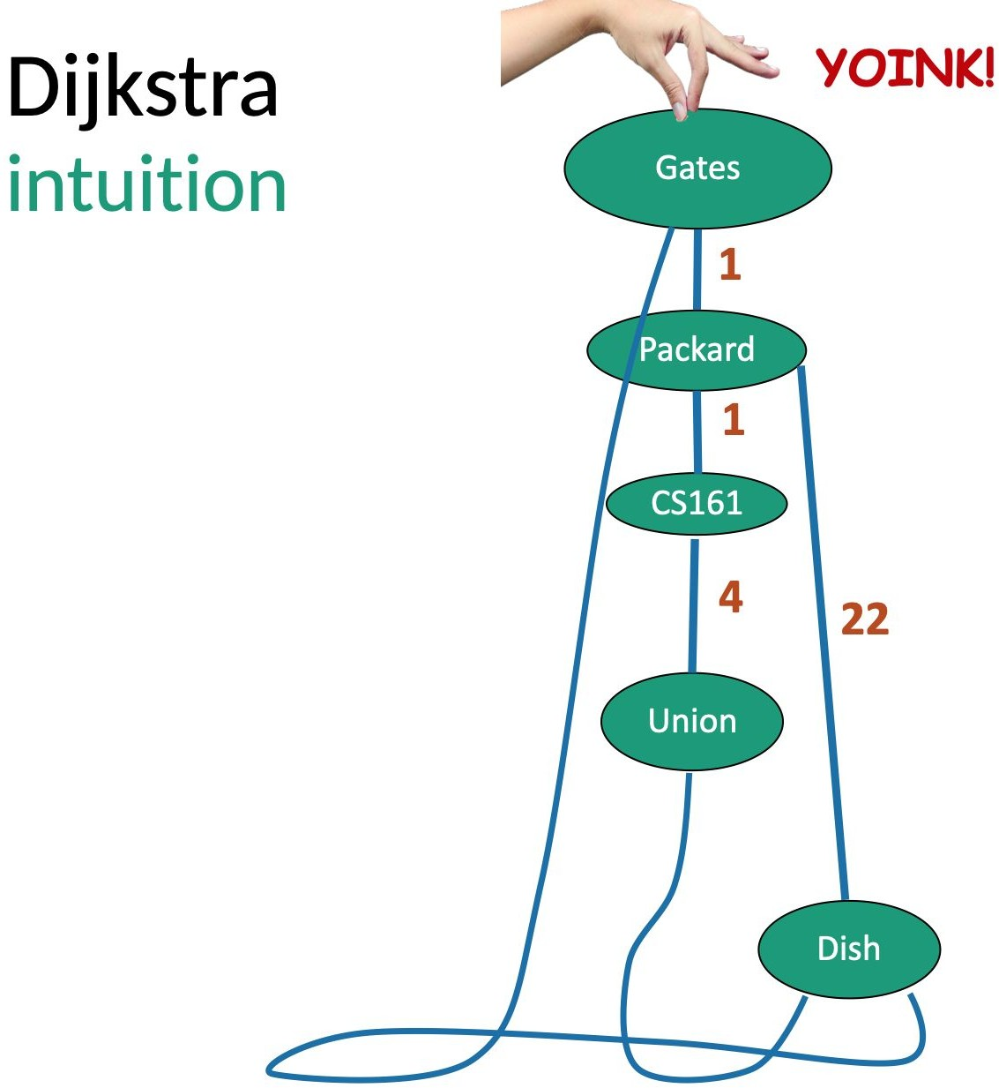

Slide 107
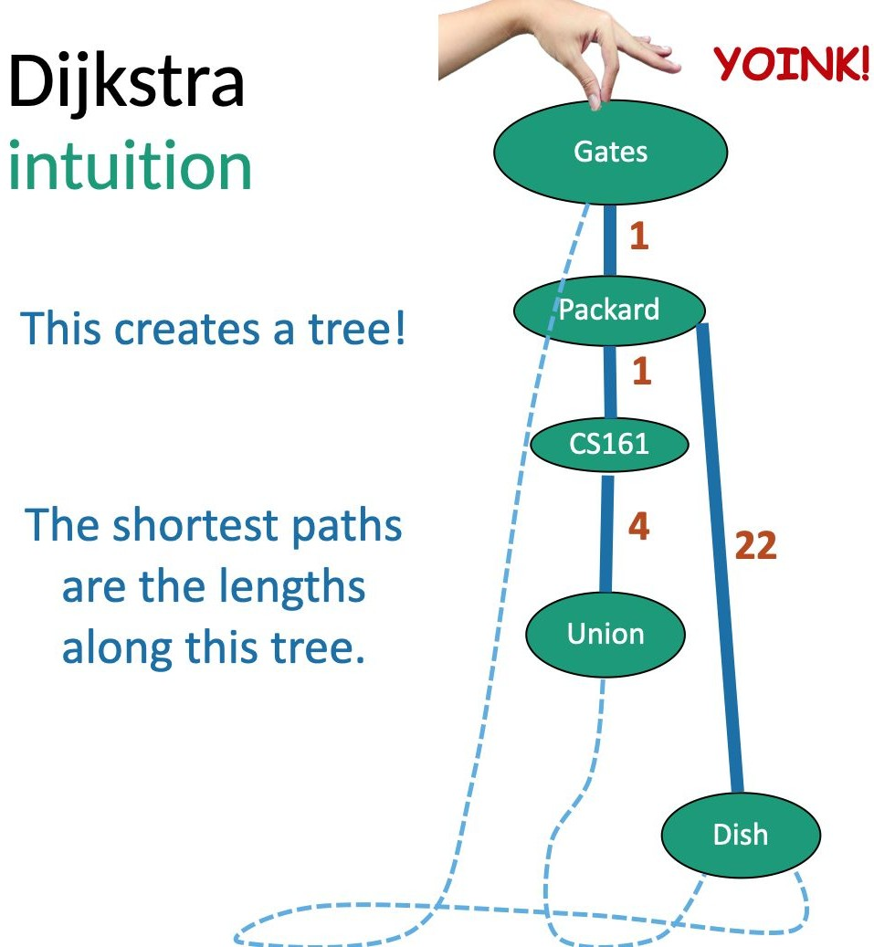

Slide 108
Motion sickness warning
I used one of Mary's examples but had some trouble copying it in a nice way.
The blame for any shifting around, small size changes, cut-off edges, etc. rests entirely upon me!

Slide 109
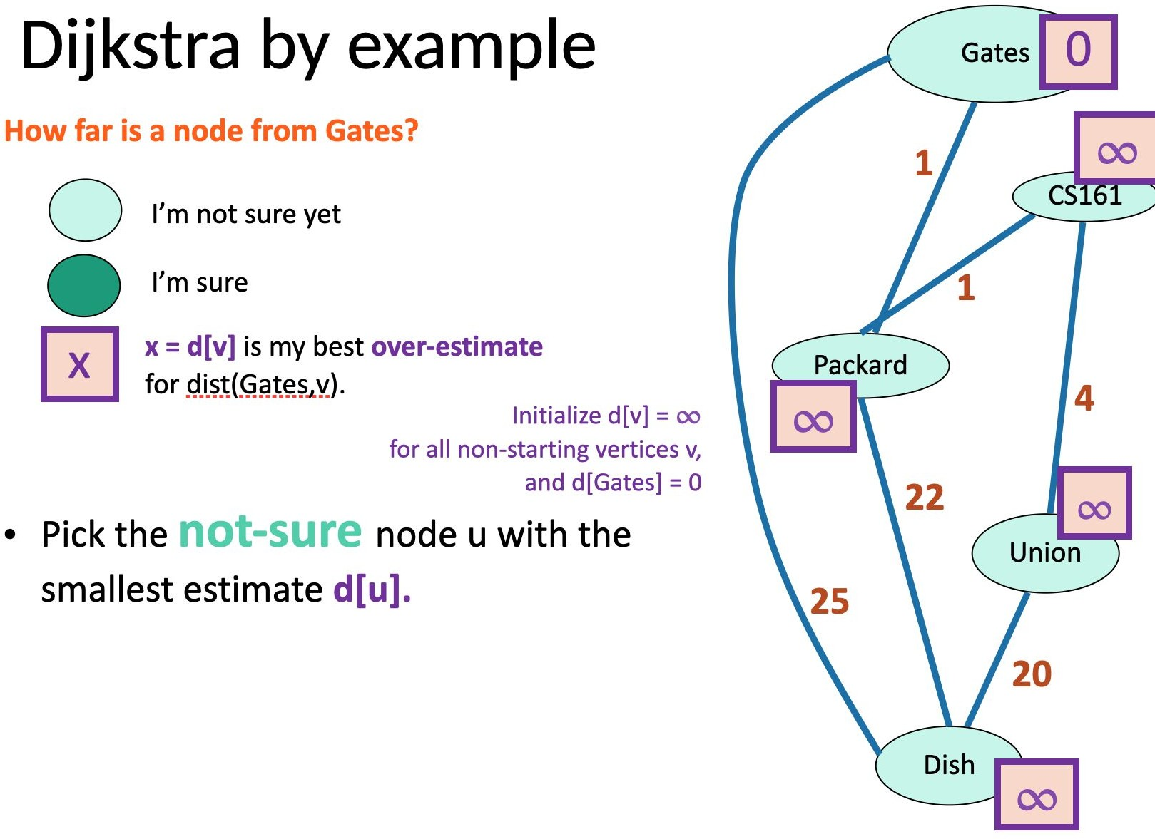

Slide 110
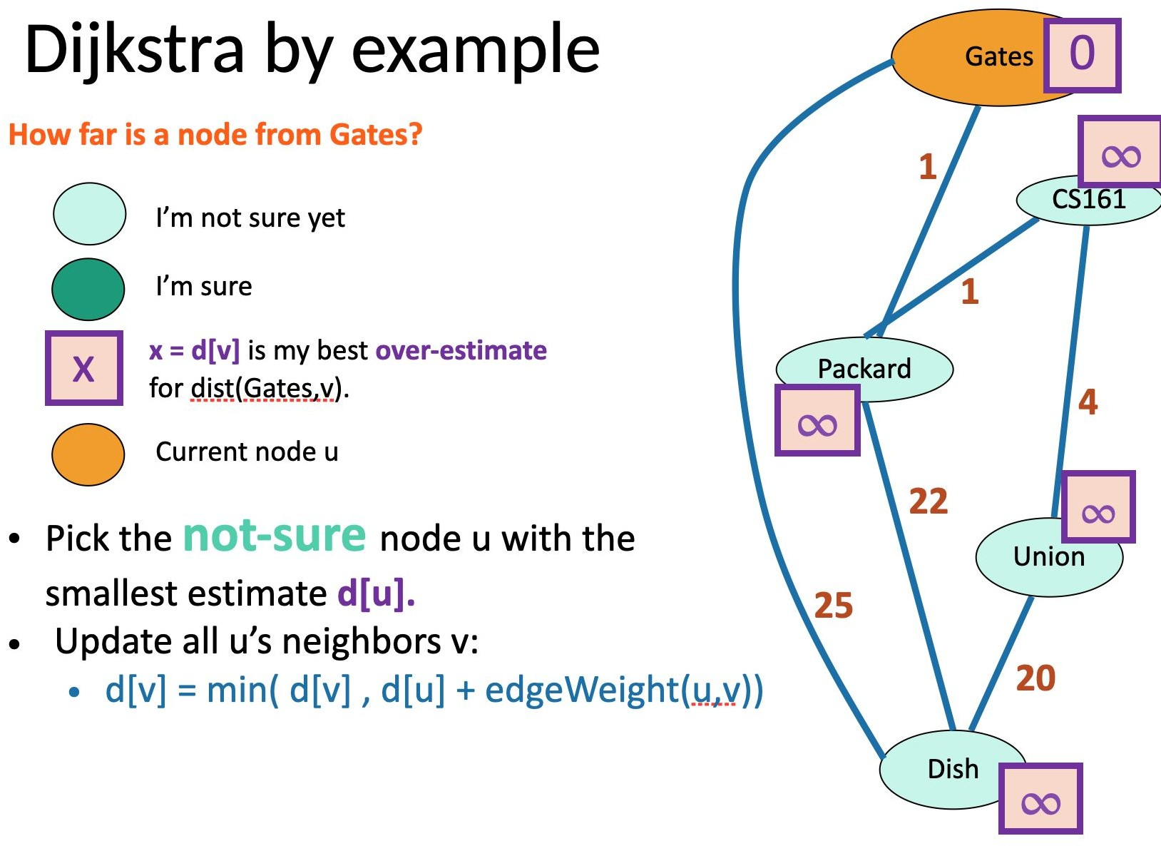

Slide 111
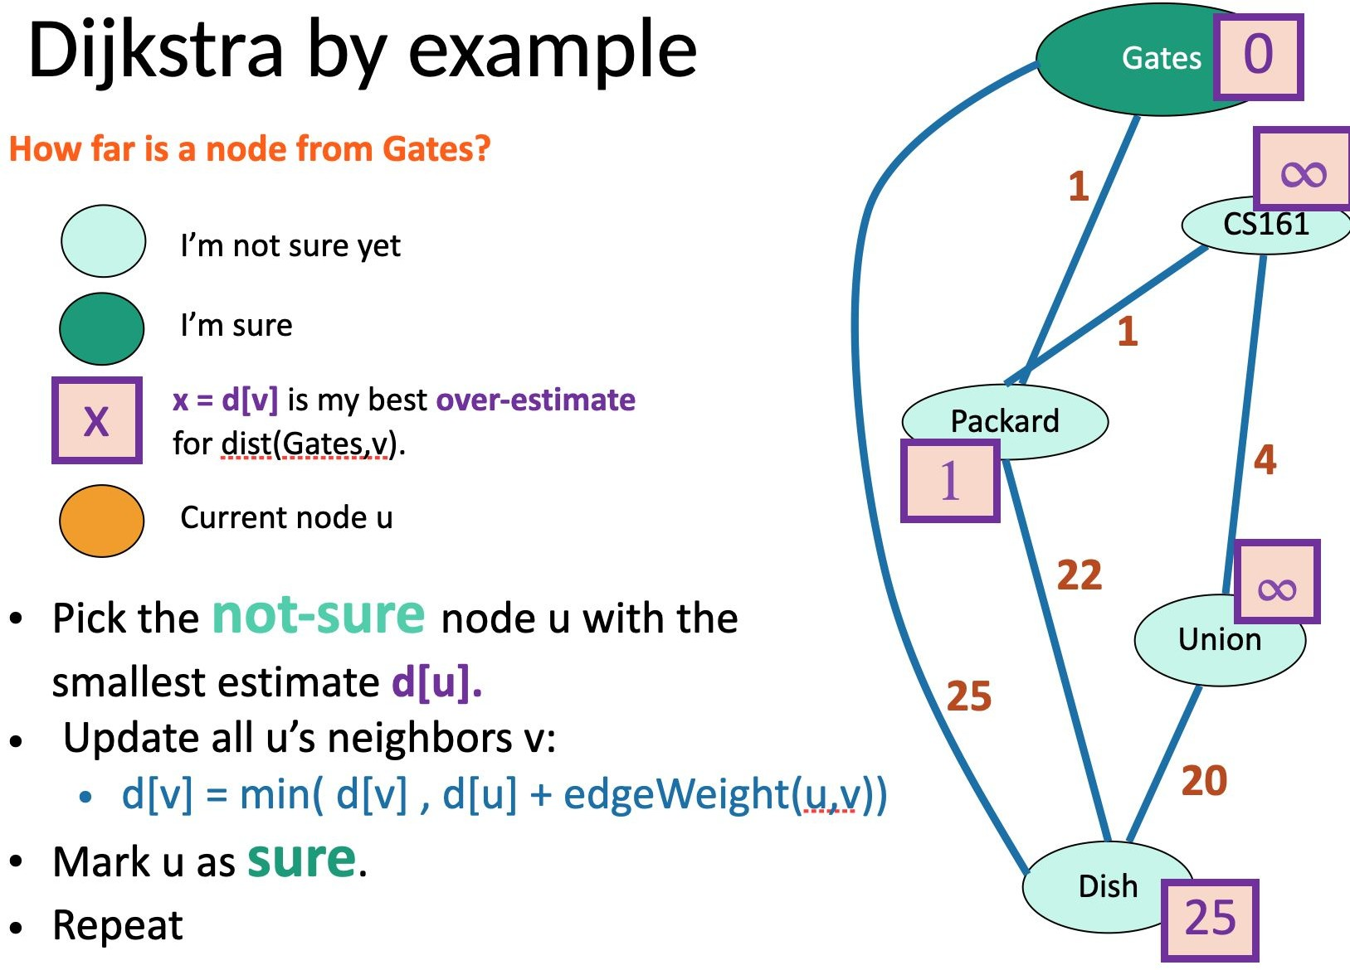

Slide 112
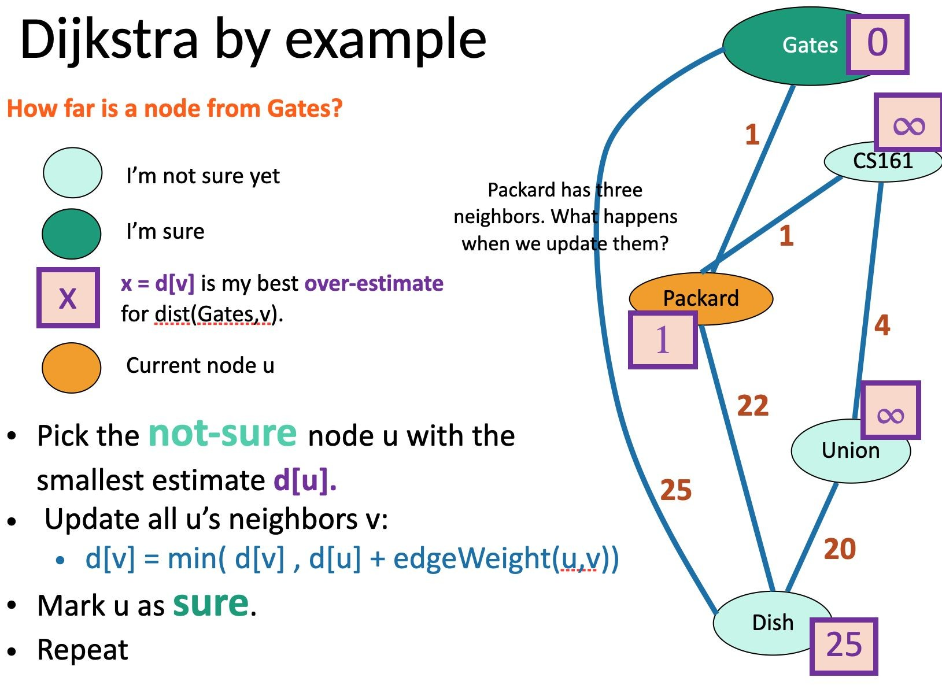

Slide 113
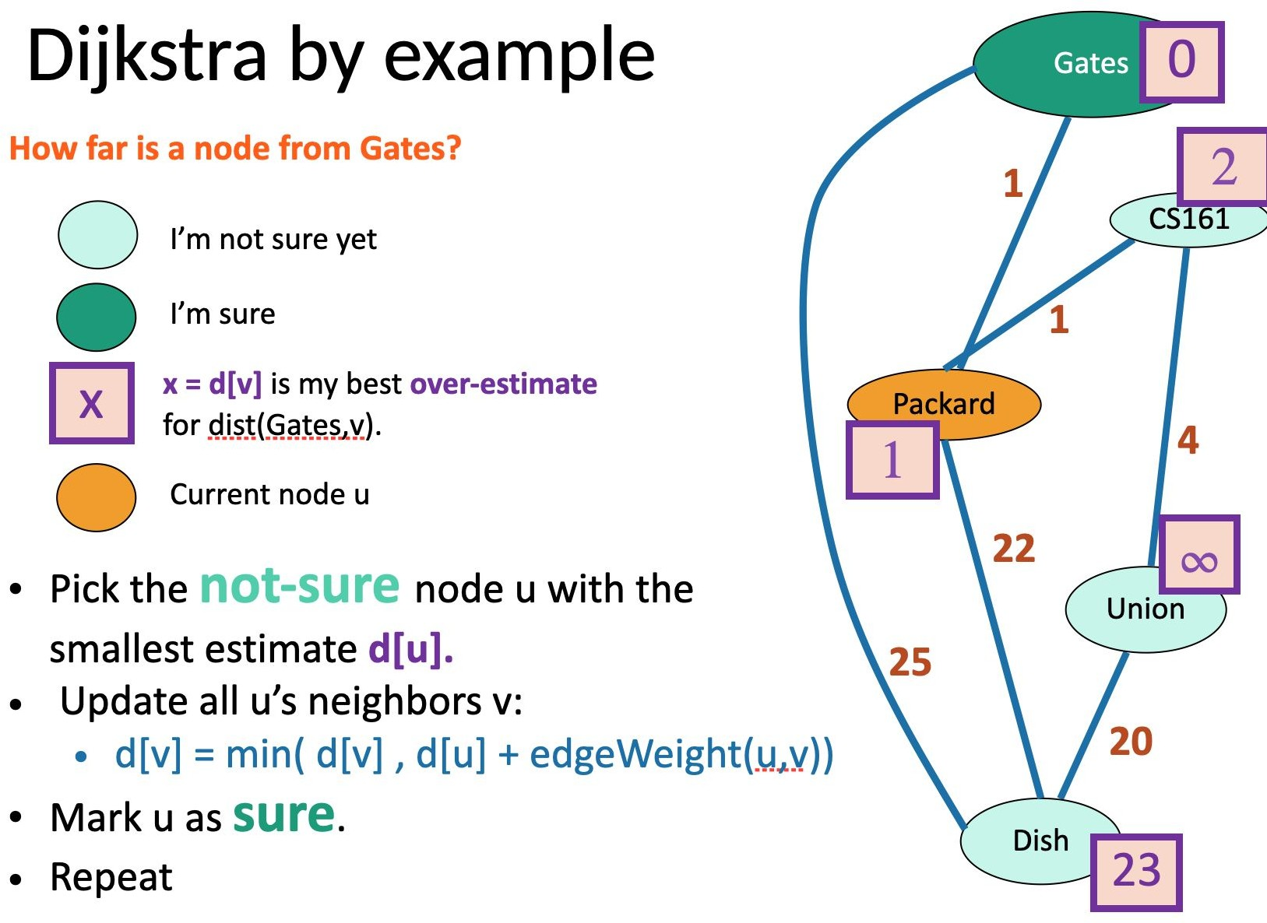

Slide 114
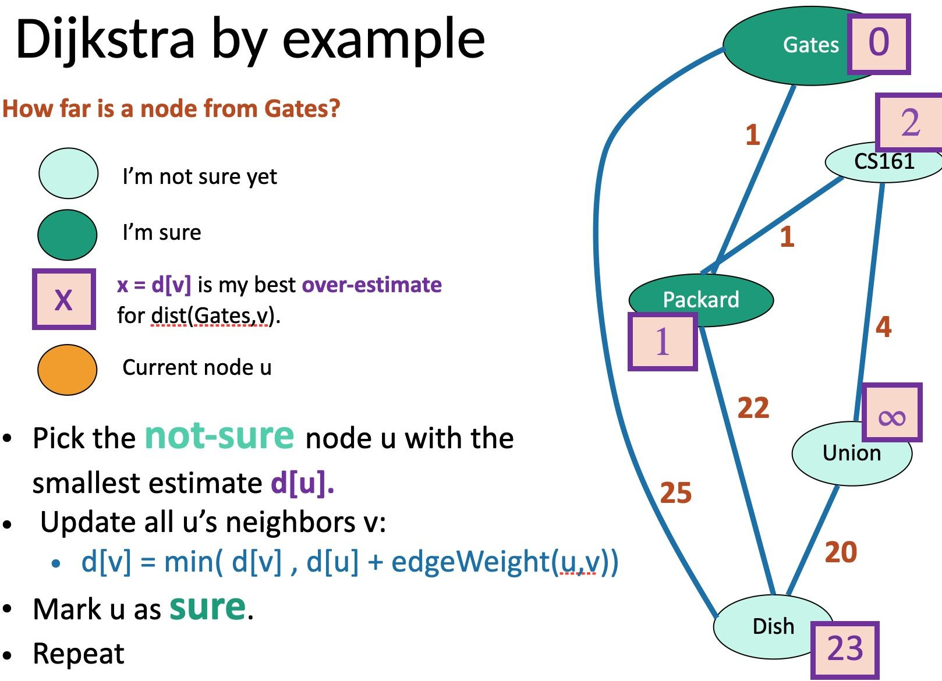

Slide 115
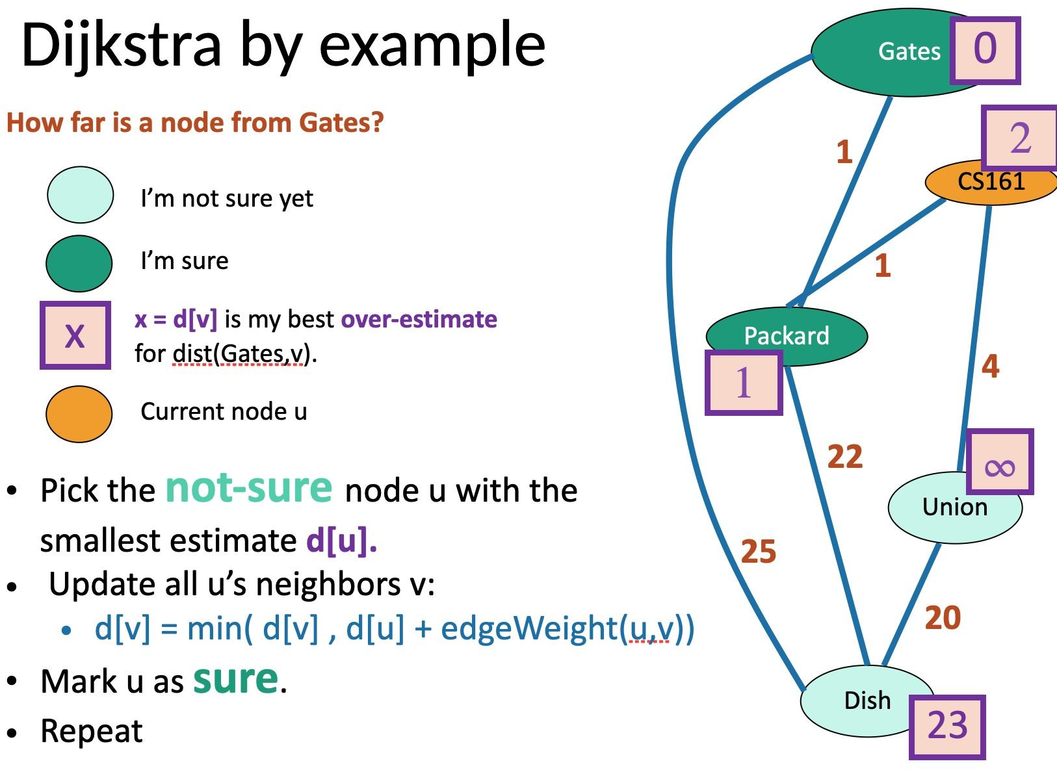

Slide 116


Slide 117
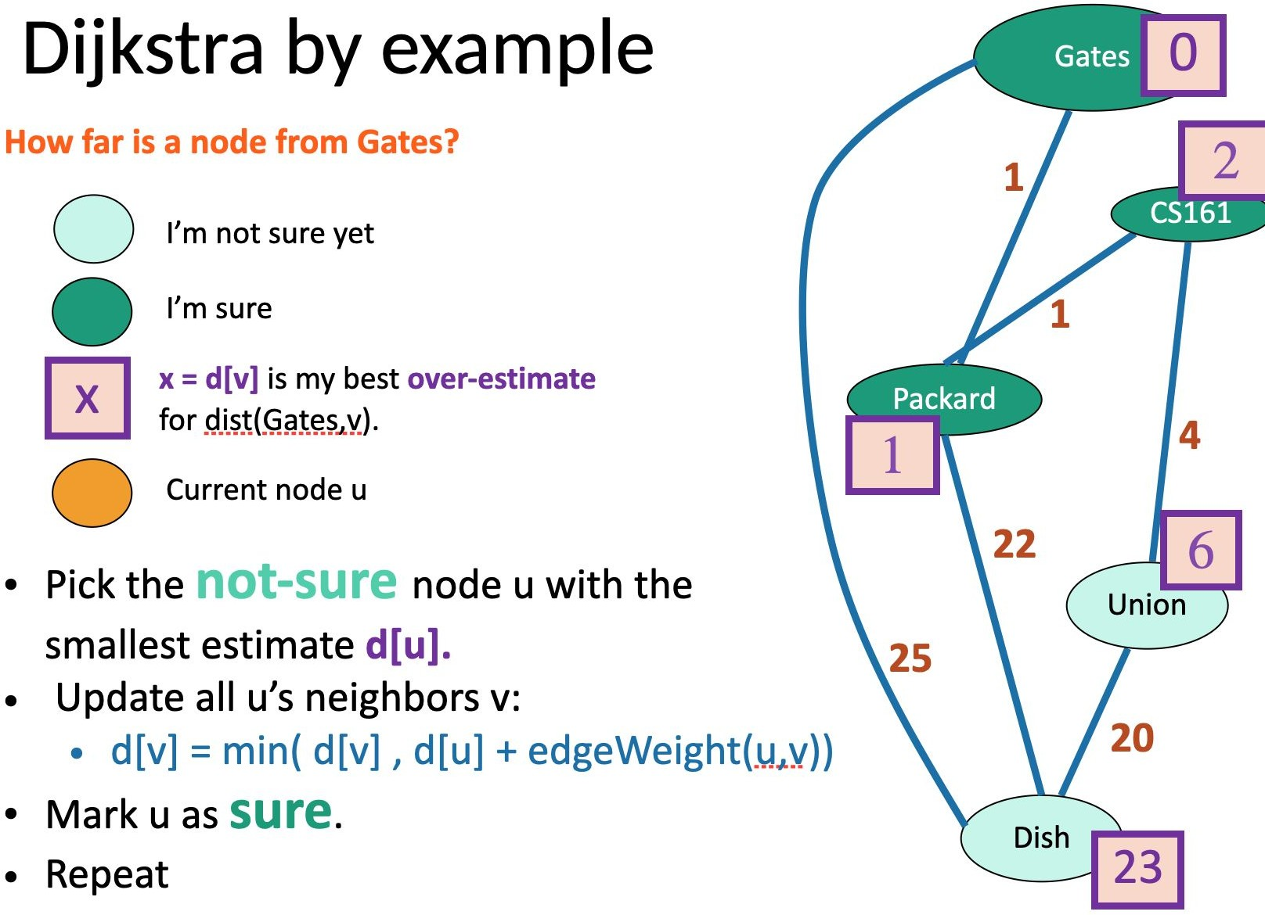

Slide 118
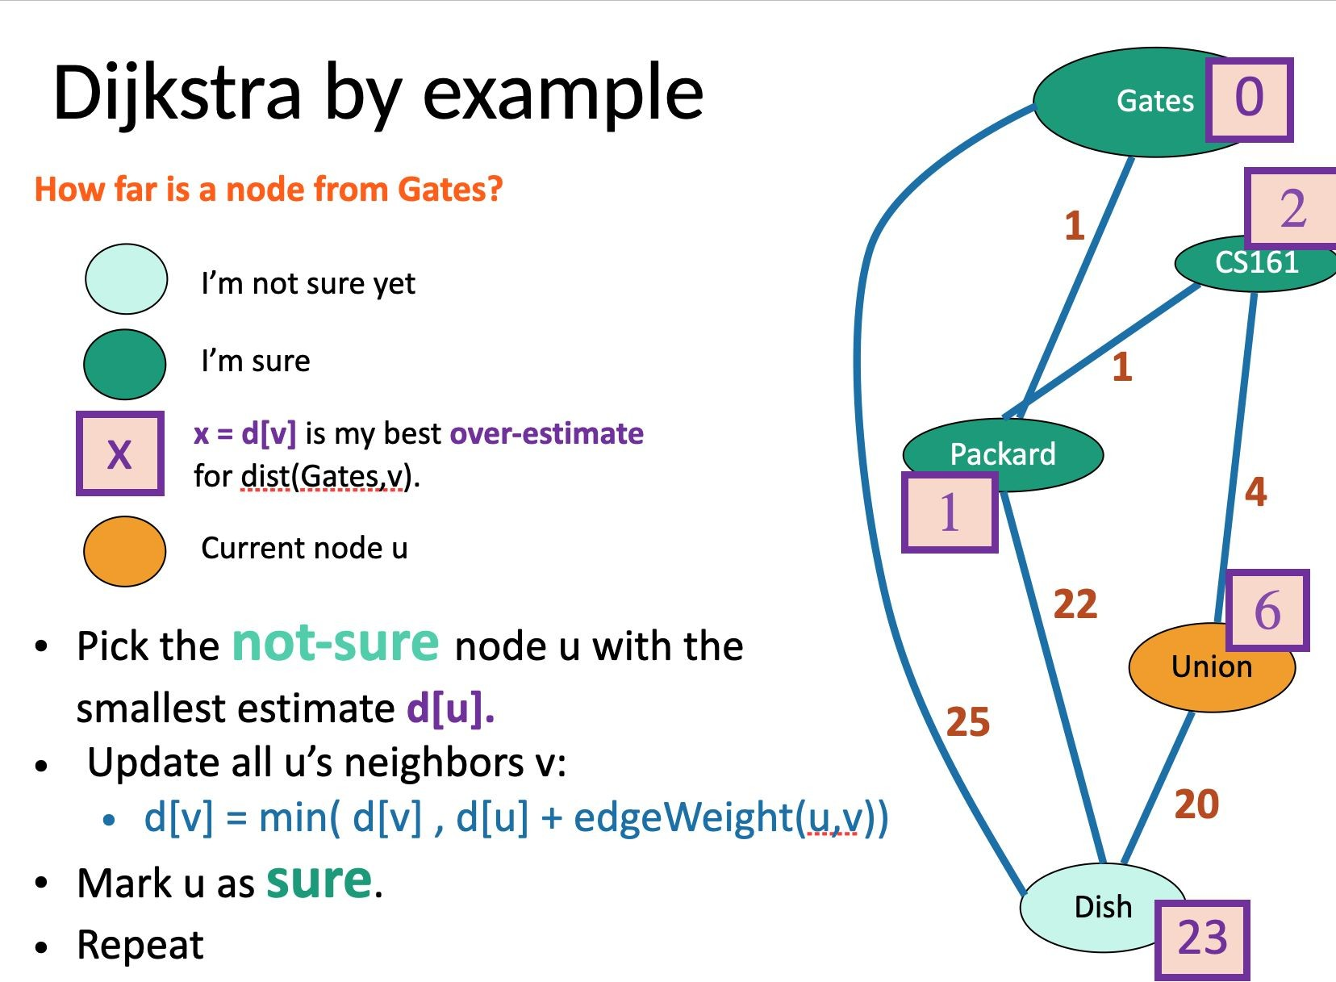

Slide 119
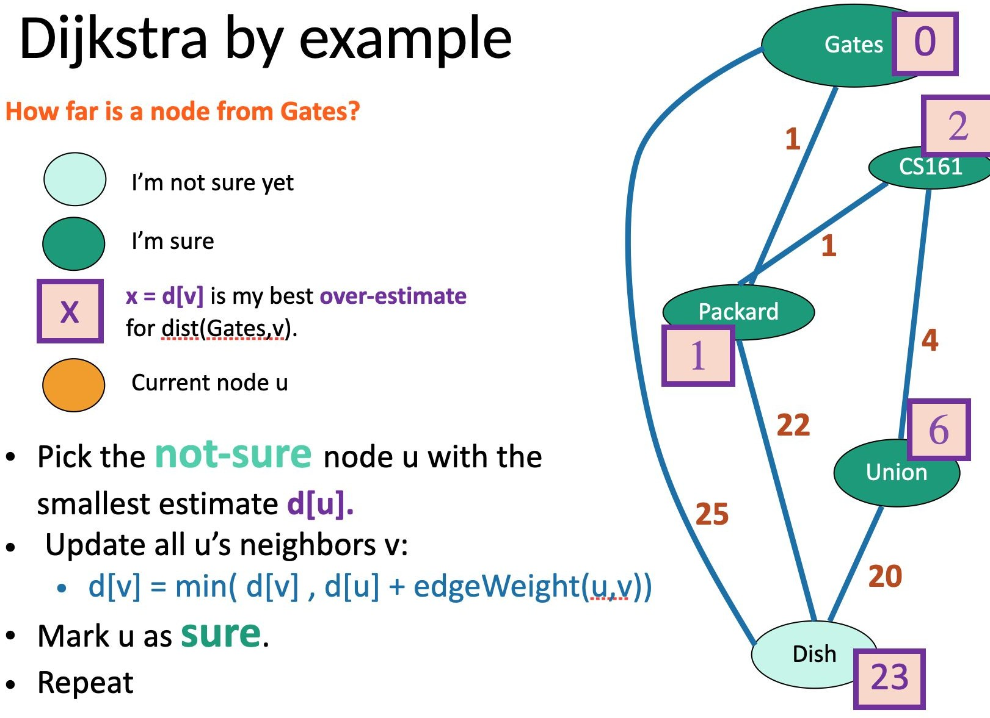

Slide 120
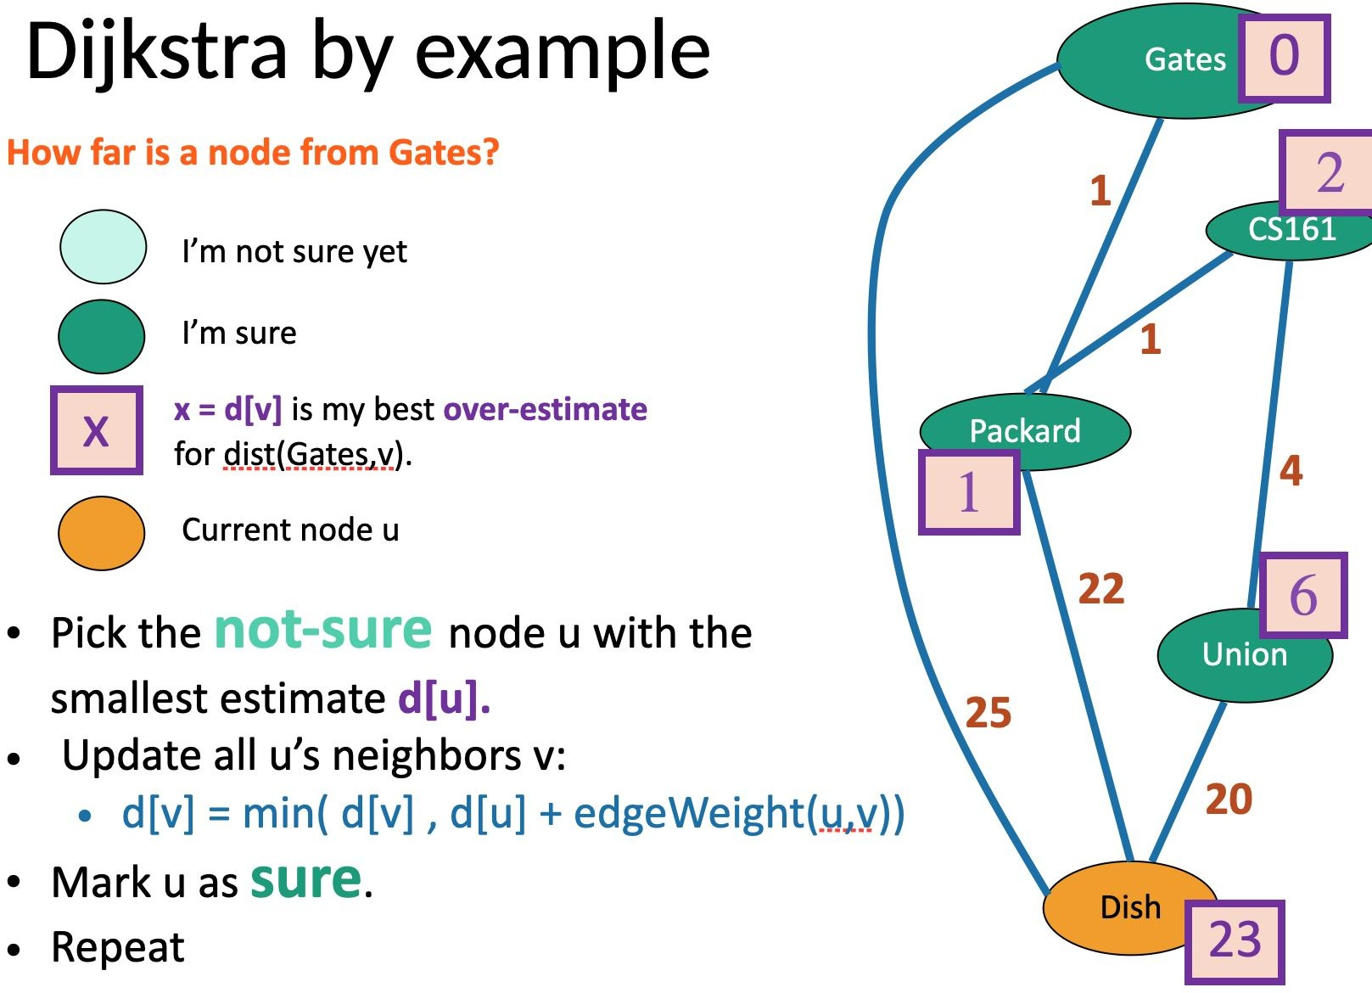

Slide 121
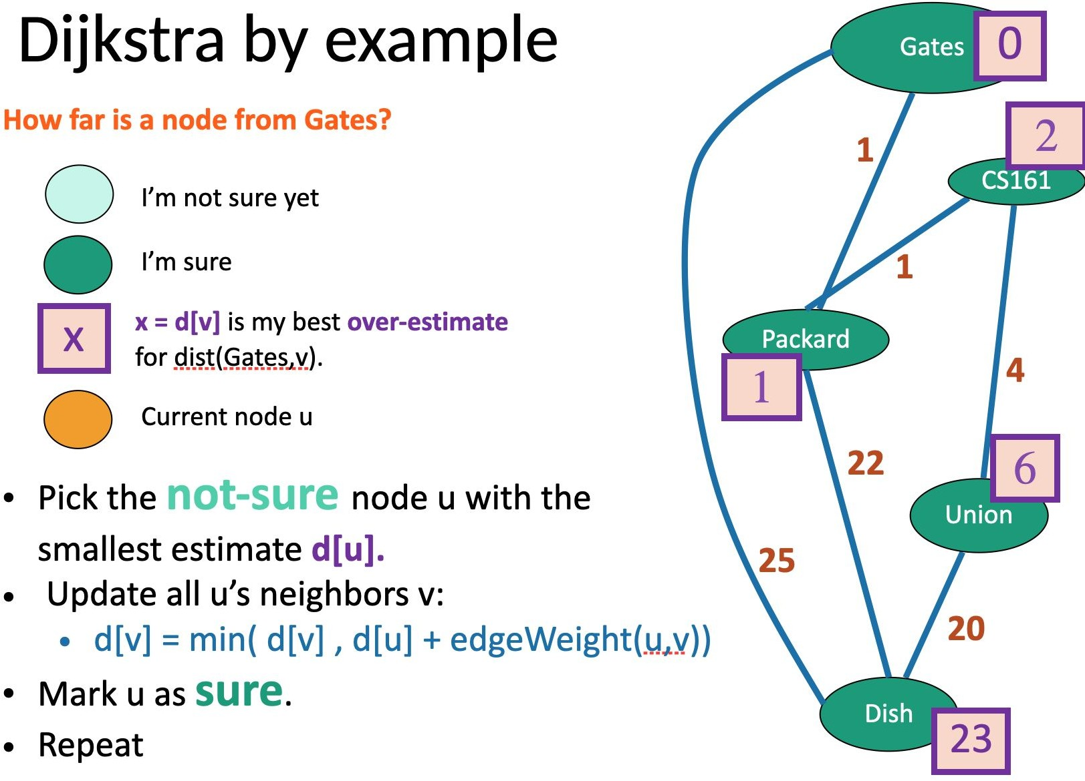

Slide 122
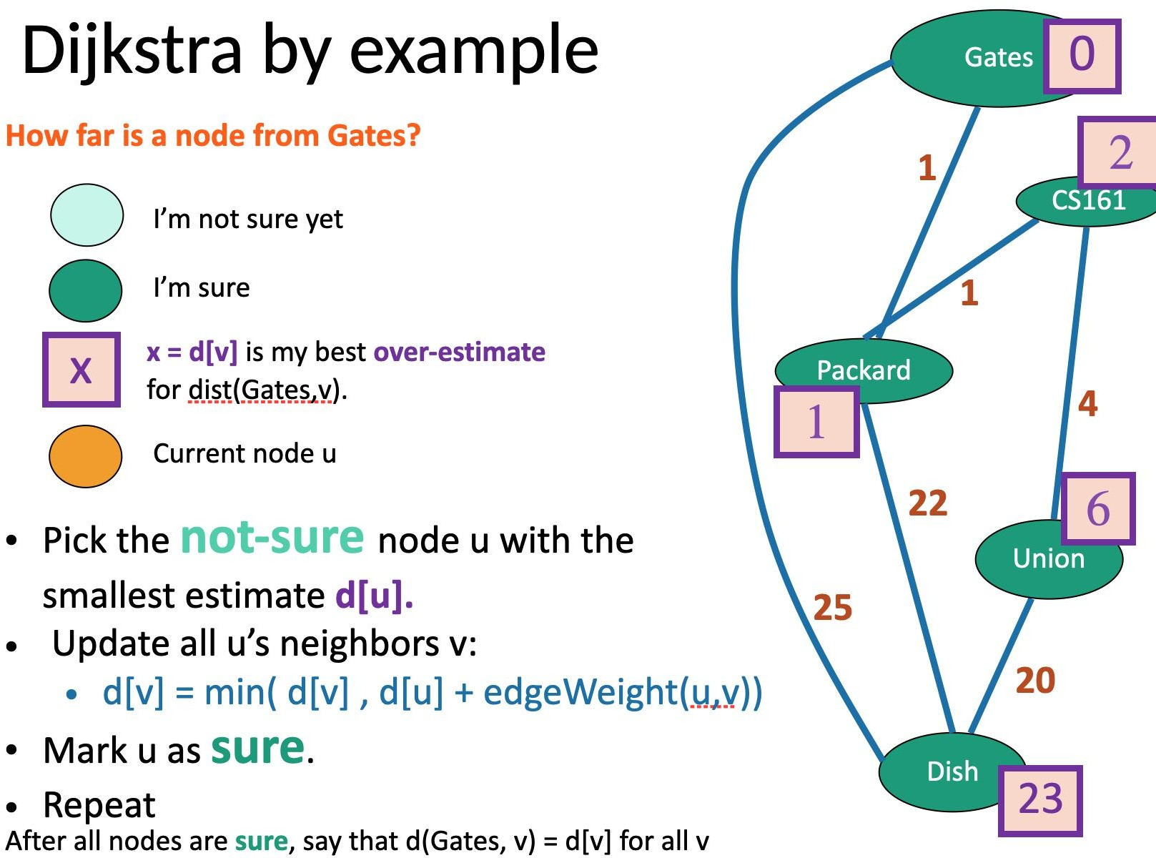

Slide 123
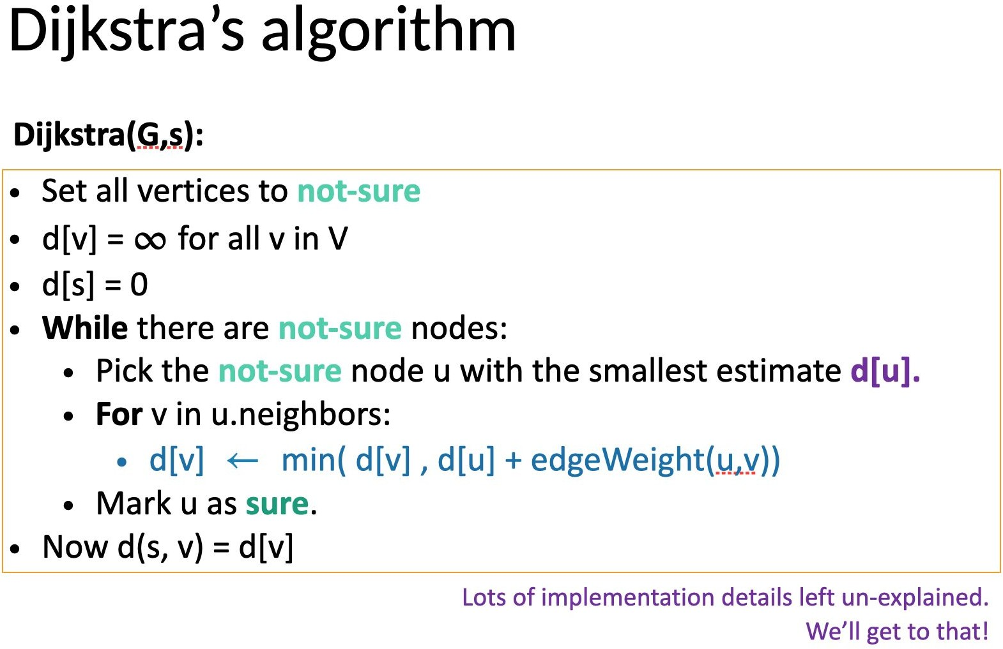

Slide 124
How can we be sure this works?
We'll prove it together on Homework 4!
(Note: that means you're not responsible for the details for the Midterm)

Slide 125
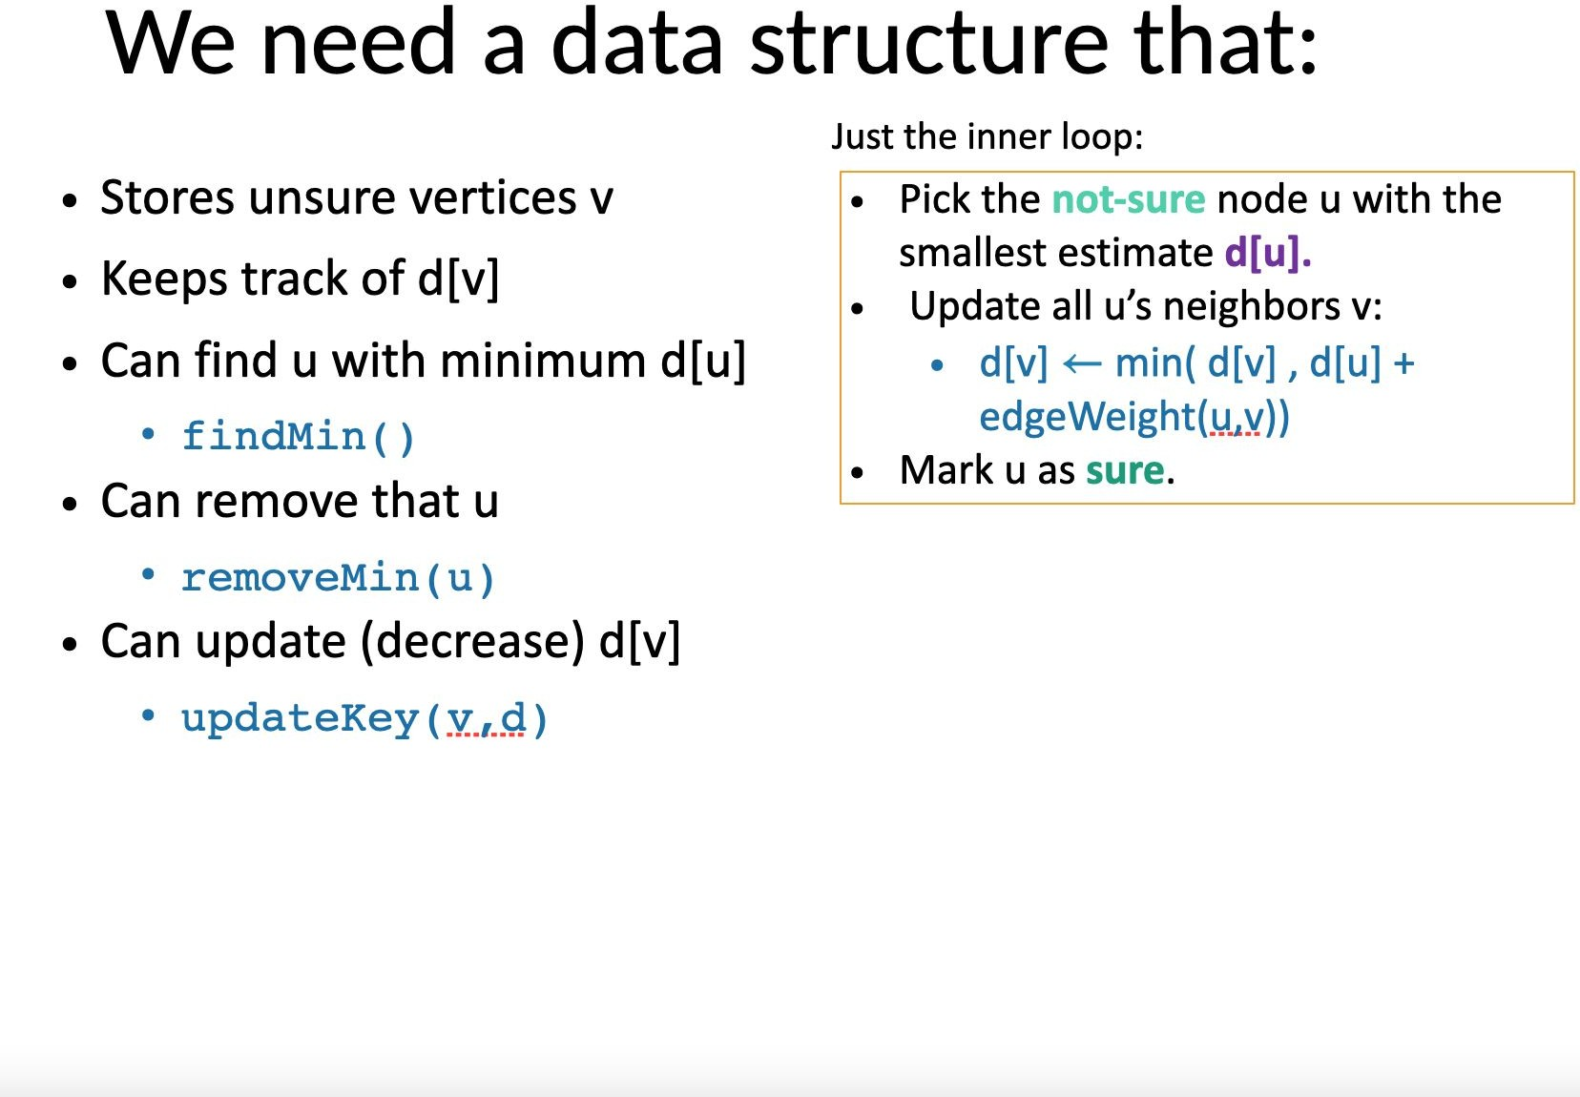

Slide 126
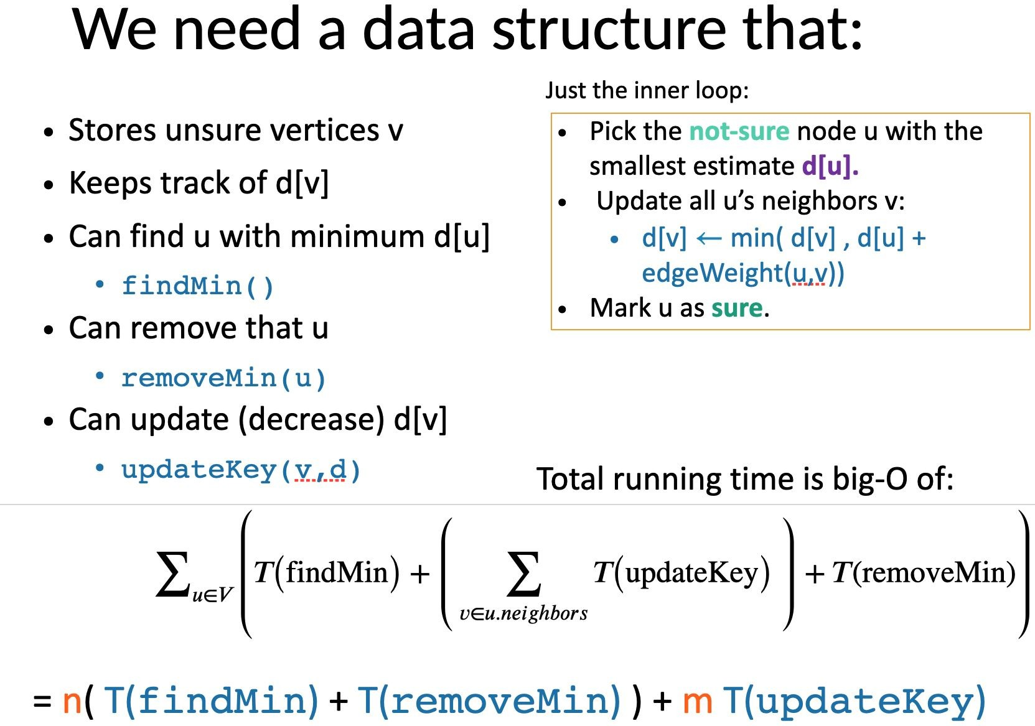

Slide 127
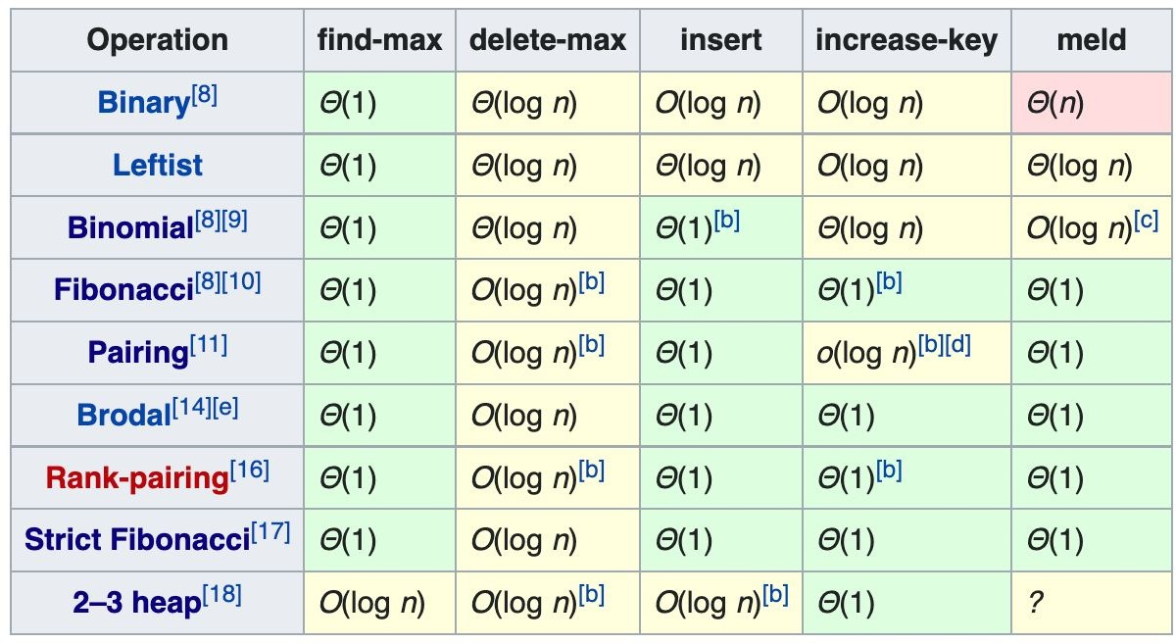
What about heaps?

Slide 128
This (well, decrease-key) is something we need to do a lot in Dijkstra's!
What about heaps?

Slide 129
This (well, decrease-key) is something we need to do a lot in Dijkstra's!
What about heaps?
Hmm…

Slide 130
Fibonacci heaps!
Actually pretty simple! Here's how they work:

Slide 131

Fibonacci heaps!
Actually pretty simple! Here's how they work:

Slide 132
Fibonacci heaps!
Actually pretty simple! Here's how they work: j/k they're horrid

Slide 133
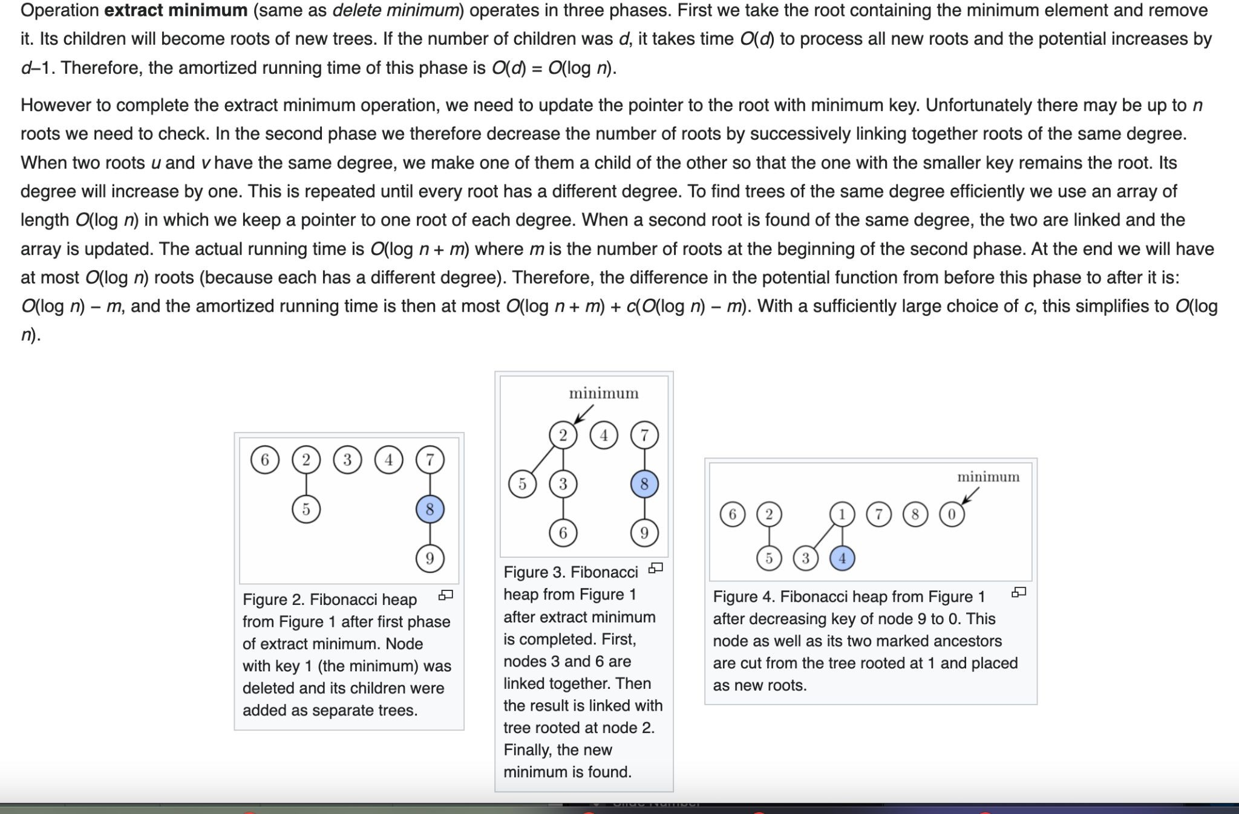
For this class, you don't need to know how they work, just the time guarantees…

Slide 134
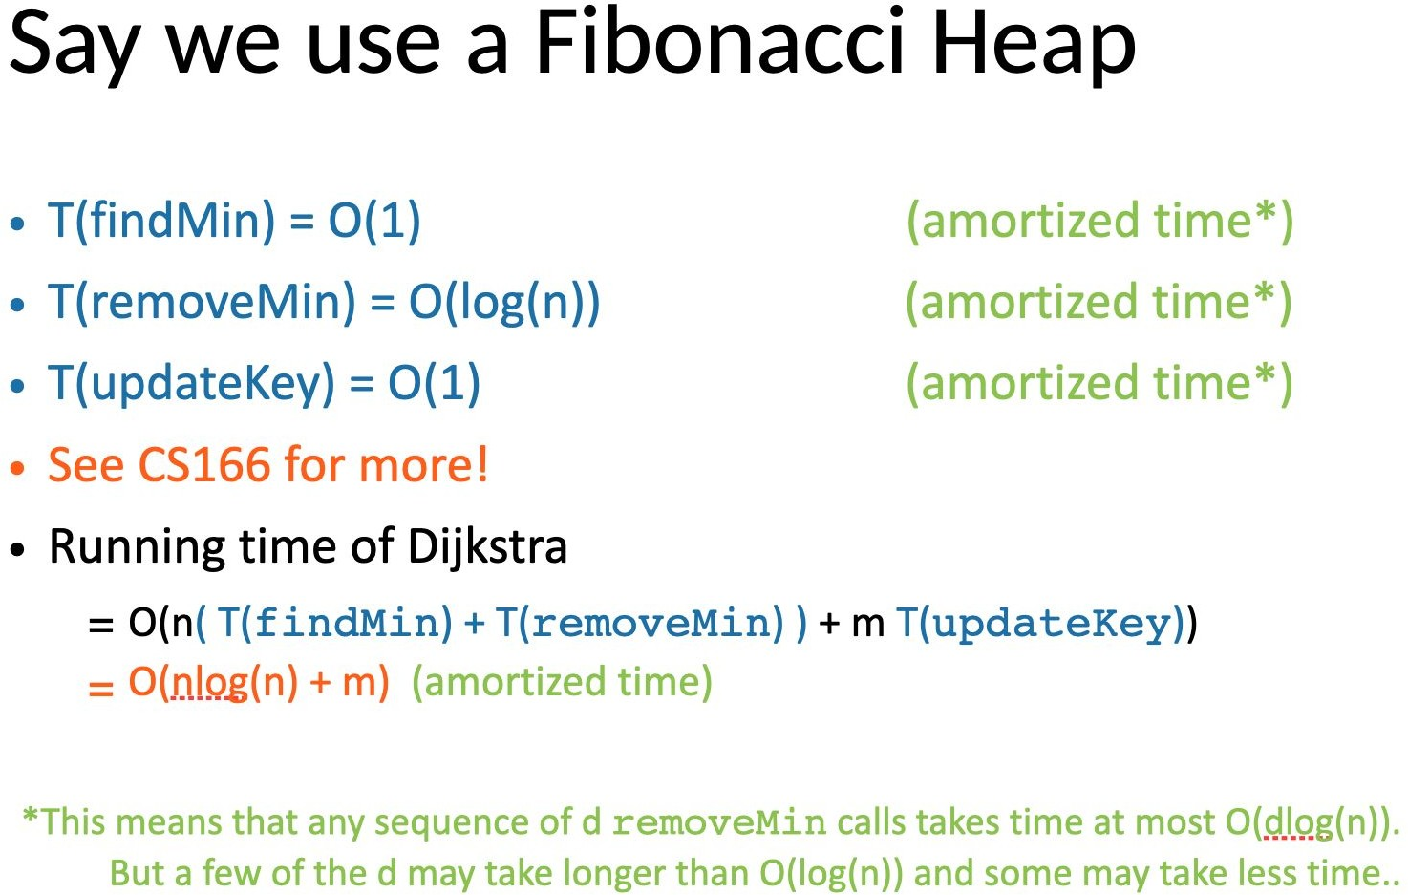

Slide 135
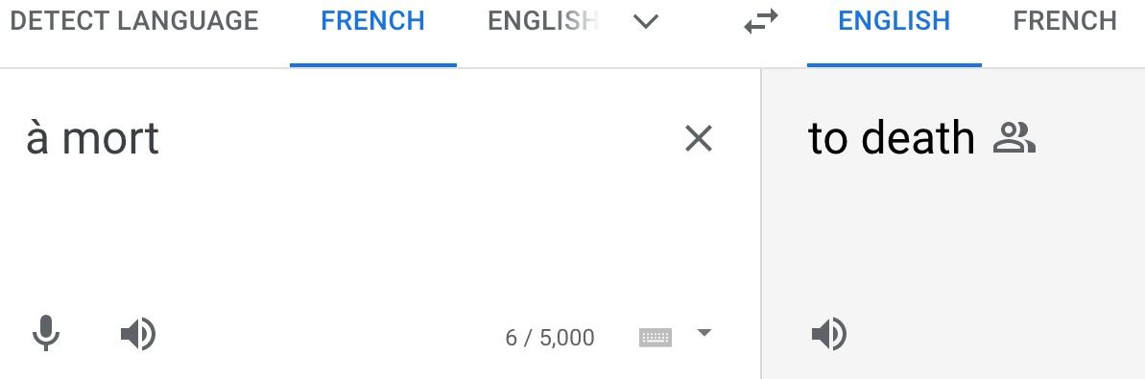
A quick note on amortized analysis
Accounting sense: this washing machine costs
$700 but we'll get to use it for 20 years, so $35/yr!
CS sense: If we say something is O(1) amortized, then at any point, the average cost so far per operation is O(1). We can't take out a loan!

Slide 136
Example: inserting into an array and resizing
Say that an array holds n elements.
Insertion is O(1) since we know where the end of the array is.
But when we run out of room, we have to create a new array with capacity 2n, and move all the existing elements there before inserting…
Isn't this "exponential"? How could it be O(1) in any sense?

Slide 137
Initial size: 2
Inseítion # | Cost | Aveíage cost so faí
1 | 1 | 1/1 = 1
2 | 1 | 2/2 = 1
3 | 4 (make new) + 2 (move) + 1 | 9/3 = 3
4 | 1 | 10/4 = 2.5
5 | 8 (make new) + 4 (move) + 1 | 23/5 = 4.6
6 | 1 | 24/6 = 4
7 | 1 | 25/7 = 3.6
8 | 1 | 26/8 = 3.3
9 | 16 (make new) + 8 (move) + 1 | 51/9 = 5.7

Slide 138
Inseítion # | Cost | Aveíage cost so faí
1 | 1 | 1/1 = 1 <= 7
2 | 1 | 2/2 = 1 <= 7
3 | 4 (make new) + 2 (move) + 1 | 9/3 = 3 <= 7
4 | 1 | 10/4 = 2.5 <= 7
5 | 8 (make new) + 4 (move) + 1 | 23/5 = 4.6 <= 7
6 | 1 | 24/6 = 4 <= 7
7 | 1 | 25/7 = 3.6 <= 7
8 | 1 | 26/8 = 3.3 <= 7
9 | 16 (make new) + 8 (move) + 1 | 51/9 = 5.7 <= 7
65537 | 131072 (make new) + 65536 (move) + 1 | 458747/65537 = 6.9998 <= 7
No matter how long this goes on, it turns out the average can never exceed 7. So insertion is O(1) amortized.

Slide 139

A little more rigor
Total cost after n inserts:
_{n * 1 + (2}ceil(log n) ₊ ₂ceil(log n) - 1 _{+ …) + (2}ceil(log n) - 1 ₊ ₂ceil(log n)- 2 ₊
…)
_{≤ n + 2}ceil(log n) + 1 ₊ ₂ceil(log n) _{≤ n + 4n + 2n = 7n}
On average, this is ≤ 7n / n = 7

Slide 140
Amortization takeaway
"O(1) amortized" does not mean that every instance of the operation is O(1).
But it does mean – at any point in the process – that the average cost of all such operations so far is O(1).
Again: no taking out loans! We can't start with one O(n) instance and then pay for it with a bunch of O(1) instances.
"I'll get the money, I swear!"

Slide 142
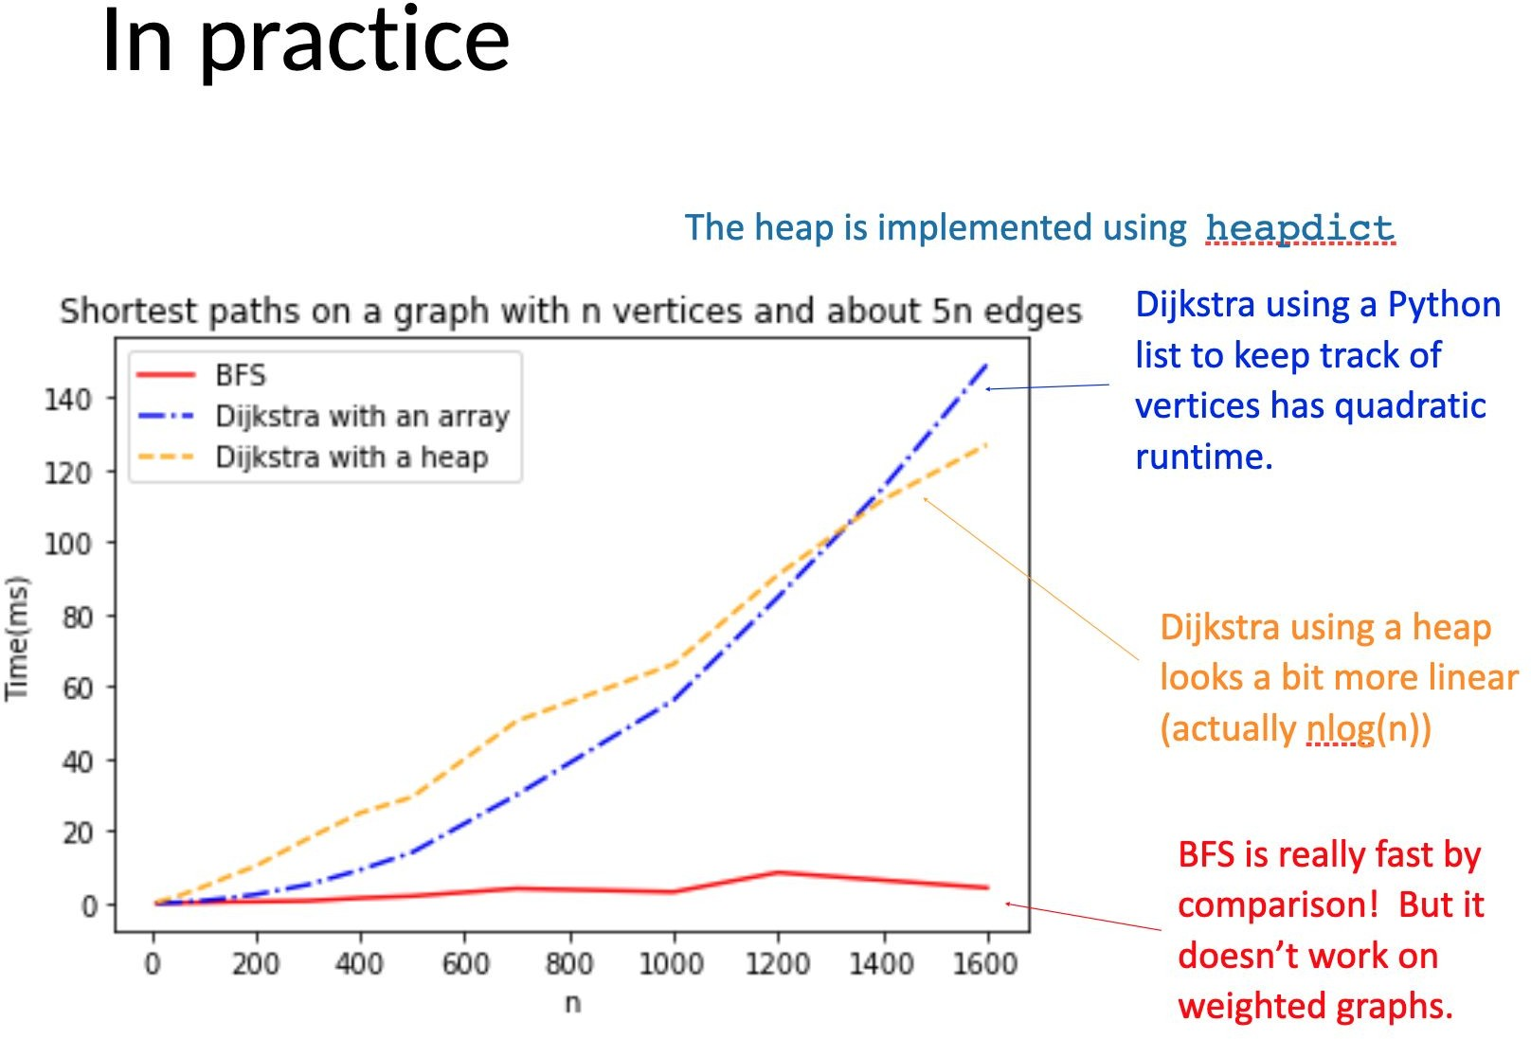

Slide 143
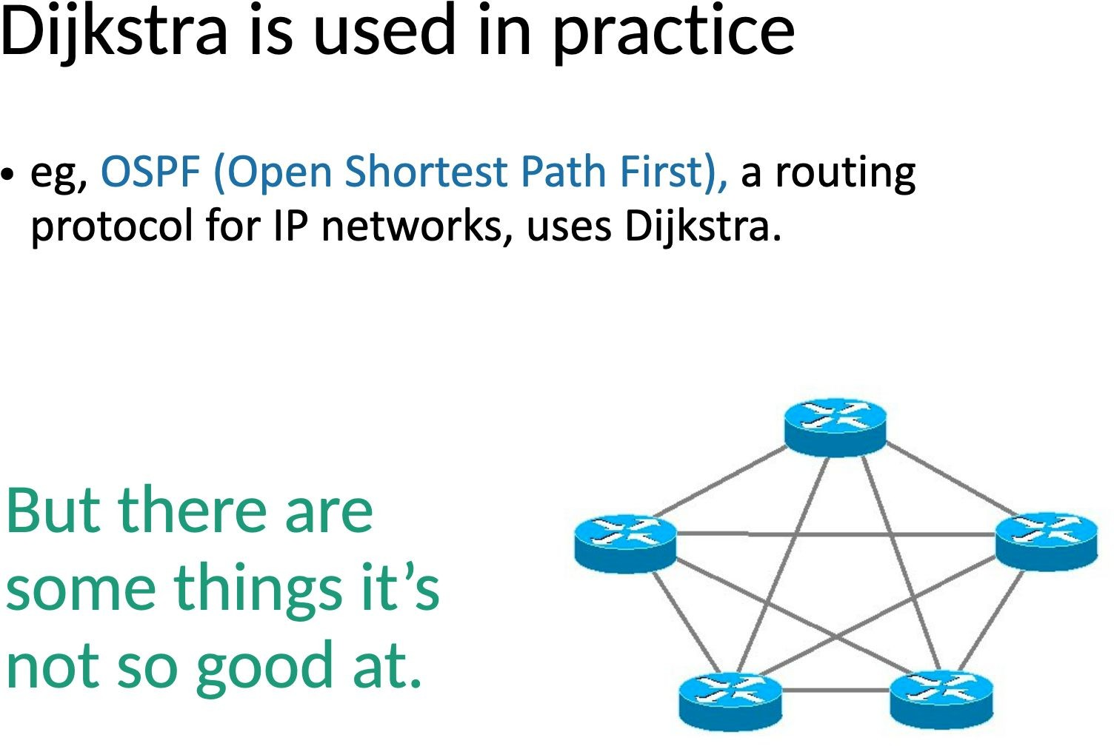

Slide 144
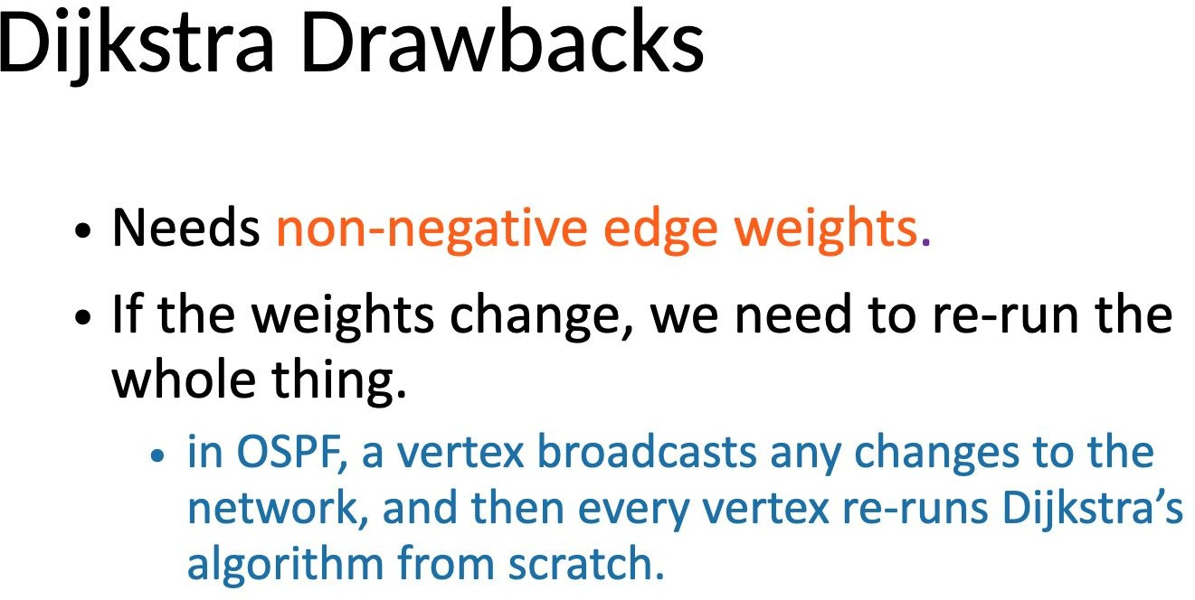

Slide 145
What's wrong with negative edge weights?
9
B
For one thing, we may stop too early, with an answer that is too big!
A
9
-17
9
(Here we get 2, but the answer is 1)
C
E
1
D
1

Slide 146

What's wrong with negative edge weights?
A possible ﬁx:
9+17
B
Add the most negative weight to every edge.
Run the algorithm.
Subtract off the added weights at the end.
A
9+17
-17
+17
9+17
C
E
1+17
D
1+17

Slide 147
What's wrong with negative edge weights?
A possible ﬁx:
9+17
B
Add the most negative weight to every edge.
Run the algorithm.
Subtract off the added weights at the end.
A
9+17
-17
+17
9+17
C
total 52
E
Does this work? No! We still end up picking the bad path because it has fewer steps.
1+17
D
total 36
1+17

Slide 148
What's wrong with negative edge weights?
Even worse: negative
1
B
cycles
A
Now the answer can be arbitrarily negative – we just go around CAEC… over and over! So the "shortest path" problem doesn't even make sense.
-3
1
1
C
E
1
D
1

Slide 149

Next time:
What if graphs can have directed edges?
And what if we go deep rather than broad?

